Slide 1
EE 231 Introduction to Optics
Scalar theory of diffraction
Lesson 10
Andrea Fratalocchi
www.primalight.org

Slide 2
The Scalar theory of diffraction
Being an electromagnetic wave, it follows from Maxwell equations
Localized intensity distribution along the transverse plane
Weak spreading of energy Slowly varying envelope
Paraxial wave equation
Homework 1: apply the remaining condition and find the localized solutions that can represent a laser light beam

Slide 3
The Scalar theory of diffraction
Being an electromagnetic wave, it follows from Maxwell equations
Localized intensity distribution along the transverse plane
Weak spreading of energy Slowly varying envelope
Paraxial wave equation
Since we know already the expression of spherical waves in paraxial approximation, we can start our search with the following trial function:

Slide 4
The Scalar theory of diffraction
By substituting into the paraxial wave equation, we obtain:
Different cases according to the value of c1

Slide 5
The Scalar theory of diffraction
By substituting into the paraxial wave equation, we obtain:
Interesting solution?

Slide 6
The Scalar theory of diffraction
By substituting into the paraxial wave equation, we obtain:
This represents a spherical wave in paraxial approximation, nothing new

Slide 7
The Scalar theory of diffraction
By substituting into the paraxial wave equation, we obtain:
2.
Interesting solution?

Slide 8
The Scalar theory of diffraction
By substituting into the paraxial wave equation, we obtain:
2.
This represents, again, a spherical wave in paraxial approximation, nothing new

Slide 9
The Scalar theory of diffraction
By substituting into the paraxial wave equation, we obtain:
3.
Interesting solution?

Slide 10
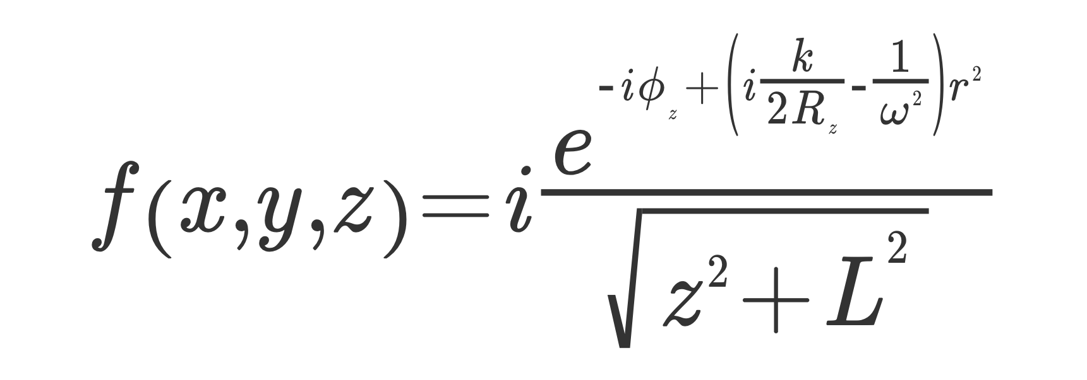
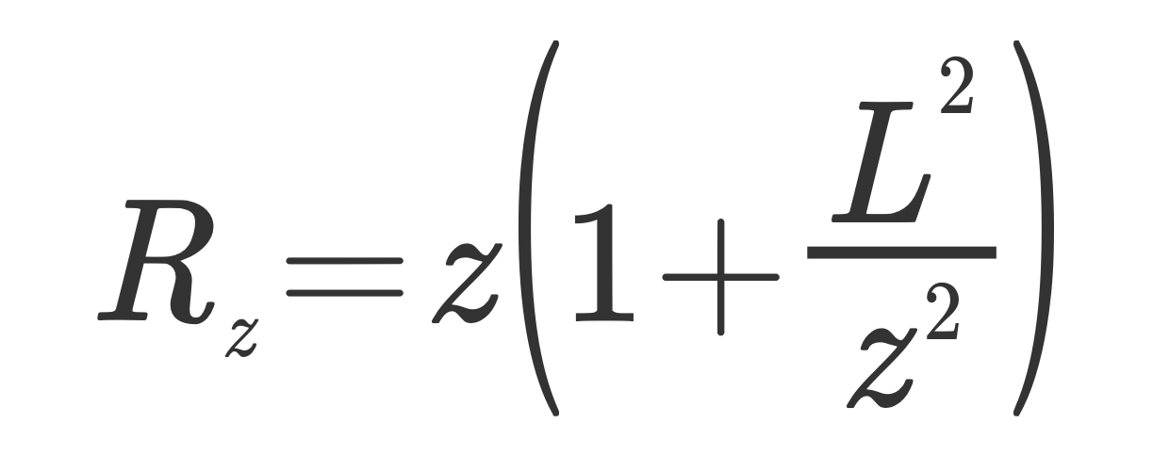
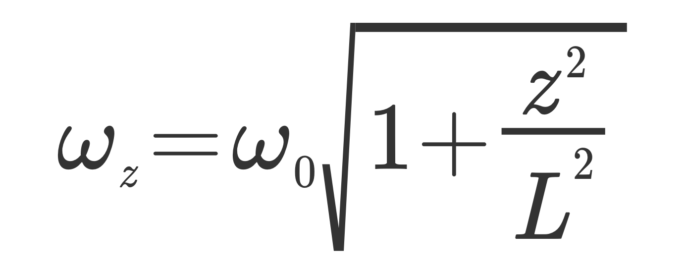
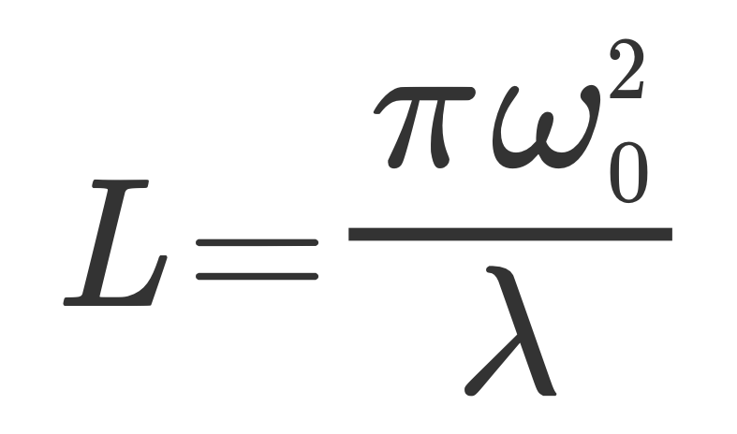
The Scalar theory of diffraction
With
And
Interesting solution!

Slide 11
The Scalar theory of diffraction
With
And
The solution found is called Gaussian Beam and represents the best approximation (in paraxial sense) of a collimated beam of light

Slide 12
The Scalar theory of diffraction
With
And
The solution found is called Gaussian Beam and represents the best approximation (in paraxial sense) of a collimated beam of light

Slide 13
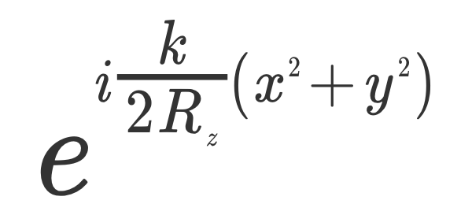
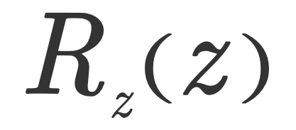
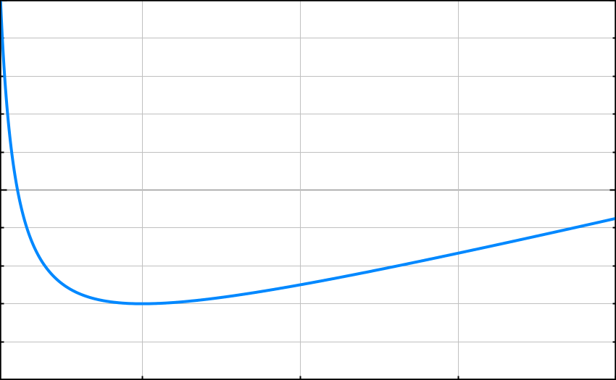
The Scalar theory of diffraction
Properties of Gaussian beams:
This terms is the expression of a spherical wave in paraxial approximation. The term Is the curvature of the wave front

Slide 14
The Scalar theory of diffraction
Properties of Gaussian beams:
This terms is the expression of a spherical wave in paraxial approximation. The term Is the curvature of the wave front

Slide 15
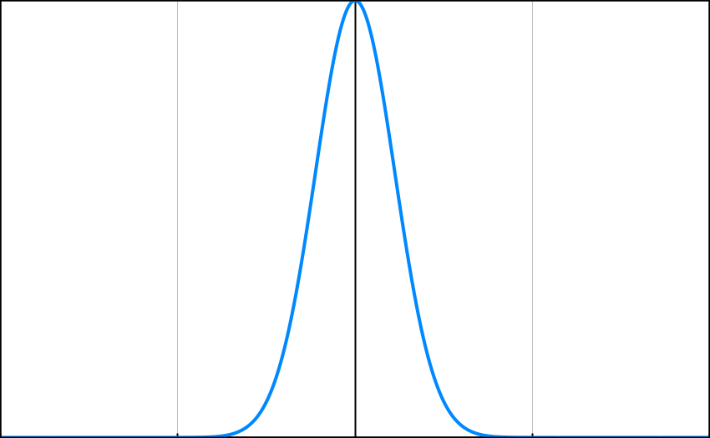
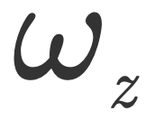
The Scalar theory of diffraction
Properties of Gaussian beams:
This term represents a spatially modulated beam along the transverse plane (x,y)
The parameter Called spot-size, measures the transverse extension of the beam

Slide 16
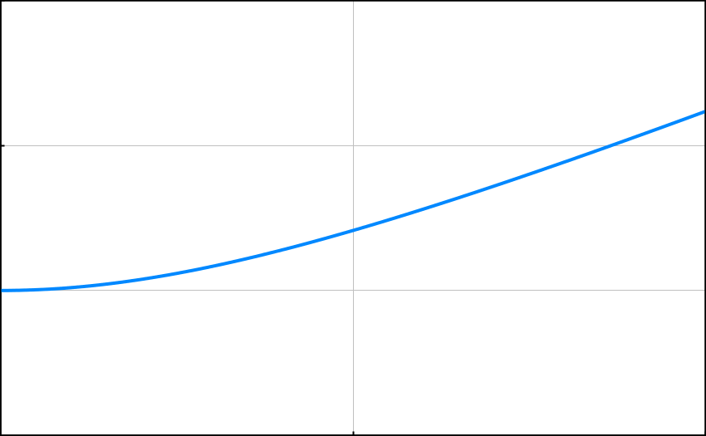
The Scalar theory of diffraction
Properties of Gaussian beams:
This term represents a spatially modulated beam along the transverse plane (x,y)

Slide 17
The Scalar theory of diffraction
Properties of Gaussian beams:
This term represents a spatially modulated beam along the transverse plane (x,y)
We can identify 2 regimes
Z<<L, The beam is well approximated by a localized plane wave, which propagates along z

Slide 18
The Scalar theory of diffraction
Properties of Gaussian beams:
This term represents a spatially modulated beam along the transverse plane (x,y)
We can identify 2 regimes
Z>>L. The beam broadens linearly with propagation z

Slide 19
The Scalar theory of diffraction
Properties of Gaussian beams:
The parameter L is the crossover between these two different regimes of propagation
We can identify 2 regimes
Z<<L, The beam is well approximated by a localized plane wave, which propagates along z
L is called Rayleigh distance. It physically corresponds to the distance where the spot-size is sqrt(2) the waist.
Z>>L. The beam broadens linearly with propagation z

Slide 20
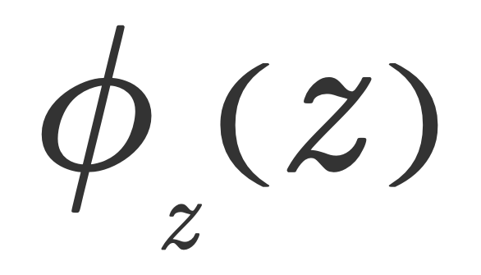
The Scalar theory of diffraction
Homework 1: evaluate the Rayleigh distance in a standard situation of wavelength 500 nm and waist 1 mm
Homework 2: Calculate the Far-Field expression of the following scalar field:
Homework 3: what about the phase term ?

Slide 21
The Scalar theory of diffraction
References
A. Yariv, Optical electronics in modern communications, Chapter 2.

