Slide 1
EE 231 Introduction to Optics
Scalar theory of diffraction
Lesson 14
Andrea Fratalocchi
www.primalight.org

Slide 2
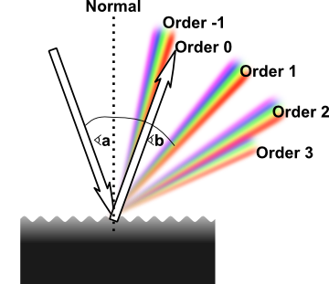
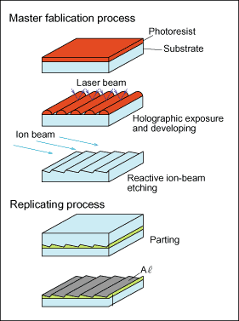
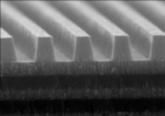
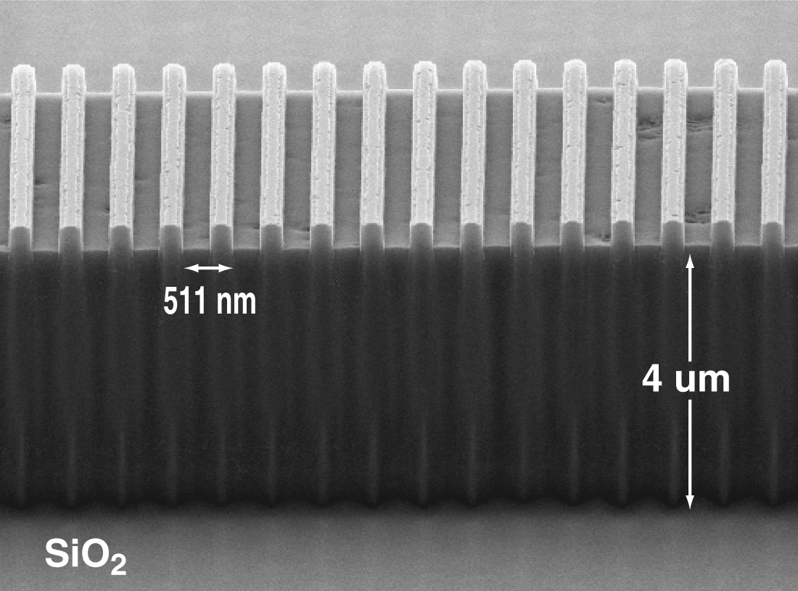
The Scalar theory of diffraction
Gratings

Slide 3
The Scalar theory of diffraction
Gratings
Gratings are optical diffractive objects characterized by a periodic transfer function.
Example:
Exercise 1: calculate the diffraction filed of an impinging generic plane wave

Slide 4
The Scalar theory of diffraction
Example:
Exercise 1: calculate the diffraction field of an impinging generic plane wave

Slide 5
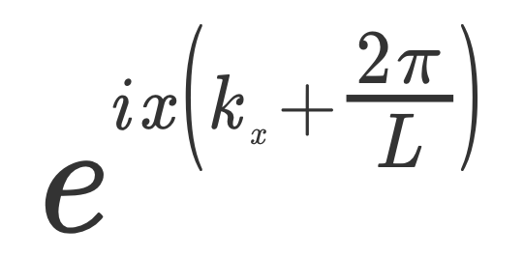
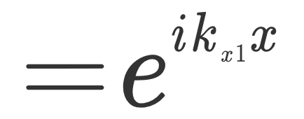
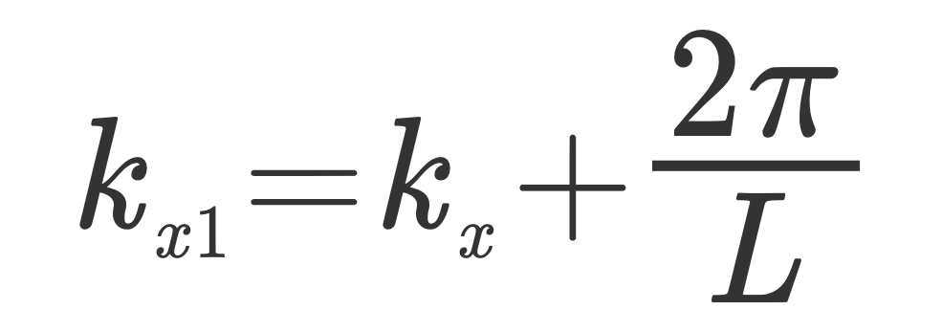
The Scalar theory of diffraction
Example:
Exercise 1: calculate the diffraction field of an impinging generic plane wave
The grating changed the wavevector!

Slide 6
The Scalar theory of diffraction
Example:
Exercise 1: calculate the diffraction field of an impinging generic plane wave
The grating changed the wavevector!

Slide 7
The Scalar theory of diffraction
Example:
Exercise 1: calculate the diffraction field of an impinging generic plane wave

Slide 8
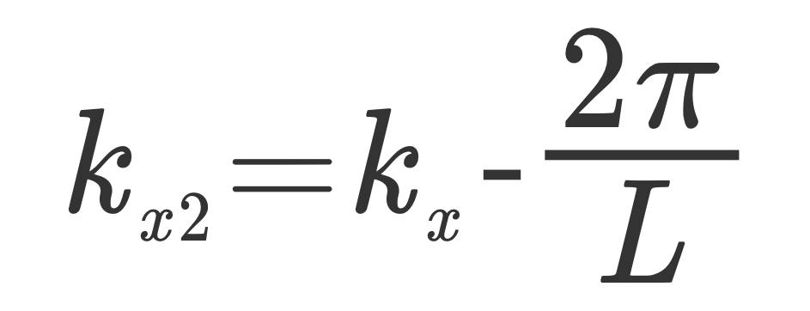
The Scalar theory of diffraction
Example:
Exercise 1: calculate the diffraction field of an impinging generic plane wave

Slide 9
The Scalar theory of diffraction
Example:
Exercise 2: calculate the far field for kx=0

Slide 10
The Scalar theory of diffraction
Example:
Exercise 2: calculate the far field for kx=0

Slide 11
The Scalar theory of diffraction
Example:
Exercise 3: how to visualize it?

Slide 12
The Scalar theory of diffraction
Example:
Exercise 3: how to visualize it?

Slide 13
The Scalar theory of diffraction
Example:
Exercise 3: how to visualize it?

Slide 14
The Scalar theory of diffraction
Example:
Exercise 4: beam steering

Slide 15
The Scalar theory of diffraction
Grating: general theory
Diffracting order
The emerging field from the grating is composed by a series of plane waves. Each plane wave defines a diffracting order.

Slide 16
The Scalar theory of diffraction
Grating: general theory
Diffracting order
The net effect of the grating is to change wavevector of the input beam

Slide 17
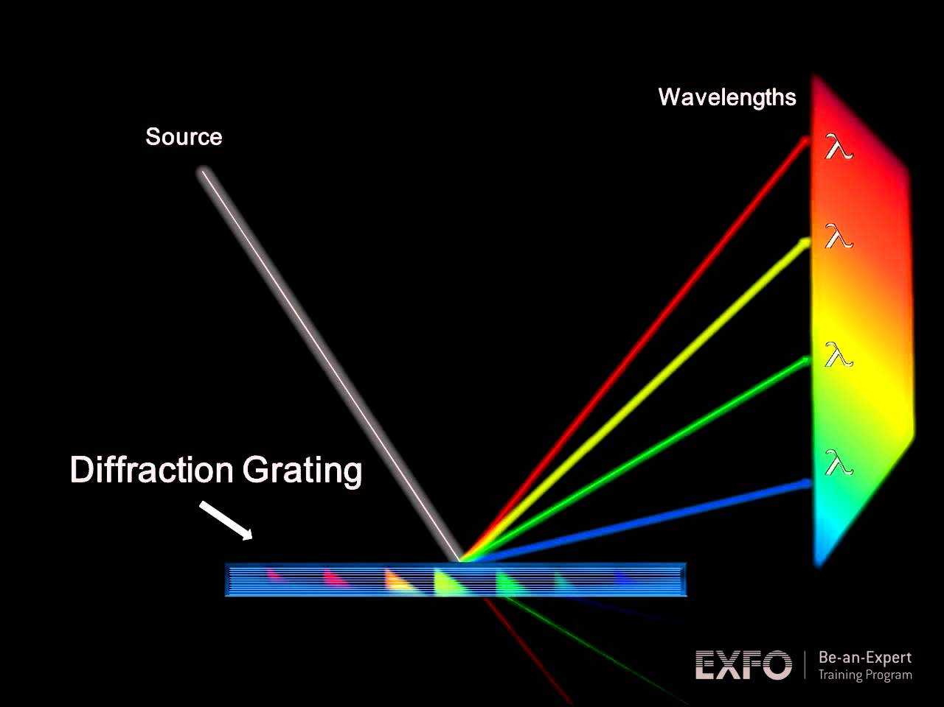
The Scalar theory of diffraction
Grating: Applications
Spectrum analyzer
How does it work?

Slide 18
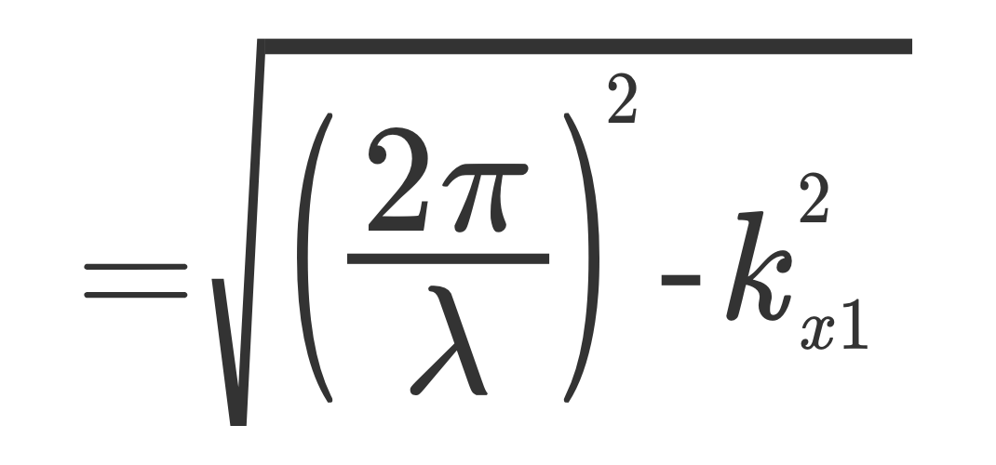
The Scalar theory of diffraction
Grating: Applications
Spectrum analyzer
How does it work?
Direction of propagation depends on the input wavelength

Slide 19
The Scalar theory of diffraction
Grating: Applications
Homework 1: how to visualize this field?
Spectrum analyzer
Direction of propagation depends on the input wavelength

Slide 20
The Scalar theory of diffraction
References
A. Yariv, Optical electronics in modern communications, Chapter 12.
H. Haus, Waves and Fields in optoelectronics, Chapter 2
Born and Wolf, Principle of Optics, Chapter 8

