Slide 1
EE 231 Introduction to Optics
Scalar theory of diffraction
Lesson 7
Andrea Fratalocchi
www.primalight.org

Slide 2
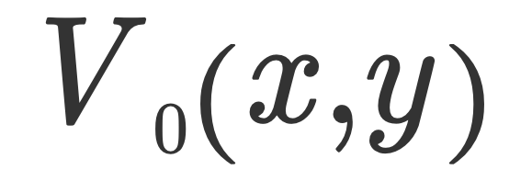
The Scalar theory of diffraction
General solution to the propagation problem
Sum up
Decompose
Propagate

Slide 3
The Scalar theory of diffraction
General solution to the propagation problem
Plane wave
Spatial frequencies
Decompose with inverse Fourier Transform

Slide 4
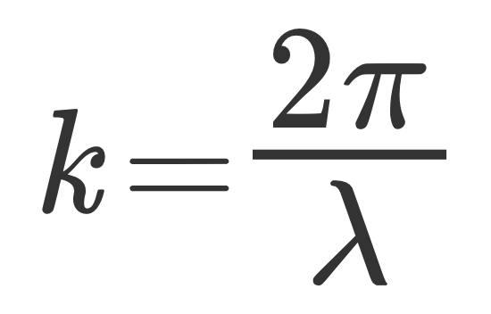
The Scalar theory of diffraction
General solution to the propagation problem
Decompose with Fourier Transform
Propagate the single plane wave

Slide 5
The Scalar theory of diffraction
General solution to the propagation problem
Propagate the single plane wave

Slide 6
The Scalar theory of diffraction
General solution to the propagation problem
Propagate the single plane wave

Slide 7
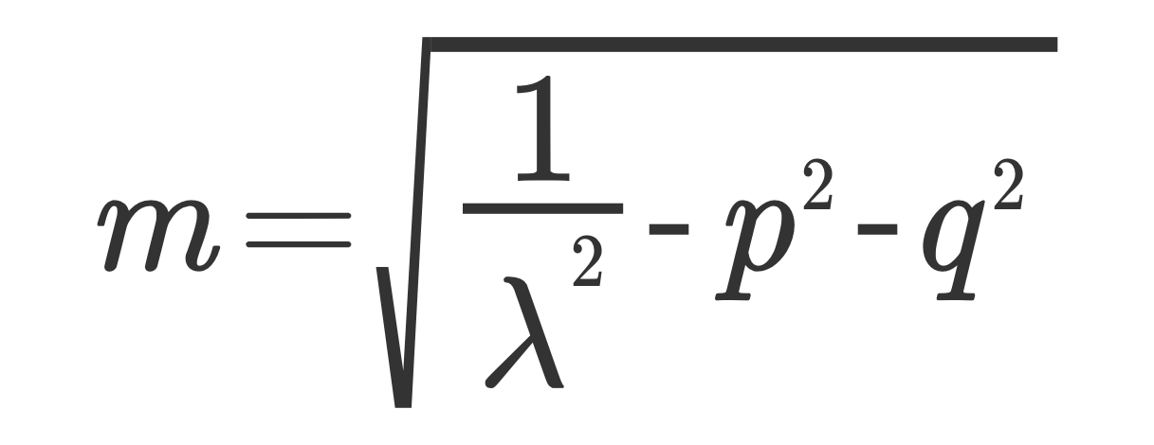
The Scalar theory of diffraction
General solution to the propagation problem
Propagate the single plane wave
Sum up all the contributions

Slide 8
The Scalar theory of diffraction
Sum up
Decompose
Propagate

Slide 9
The Scalar theory of diffraction
Does not explicitly contains the input scalar field
How can we express the output field as a function of the input?

Slide 10
The Scalar theory of diffraction
Does not explicitly contains the input scalar field
How can we express the output field as a function of the input?
Fourier transform of

Slide 11
The Scalar theory of diffraction
By substituting
Into
We finally obtain:

Slide 12
The Scalar theory of diffraction
We therefore have:

Slide 13
The Scalar theory of diffraction
We therefore have:
According to the value of the spatial harmonics p and q, we can have 2 different scenario:

Slide 14
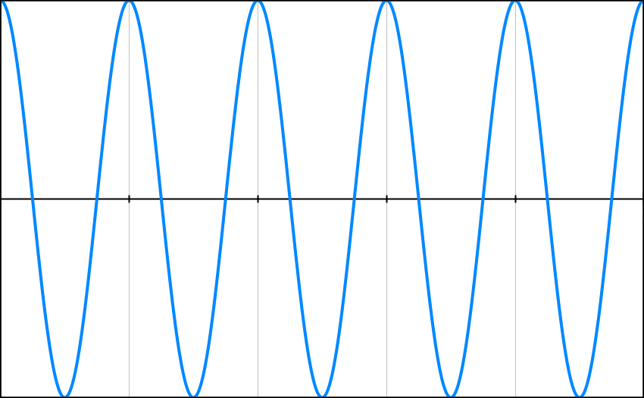
The Scalar theory of diffraction
According to the value of the spatial harmonics p and q, we can have 2 different scenario:
Homogeneous plane wave with real propagation constant kz=2*pi*m

Slide 15
The Scalar theory of diffraction
According to the value of the spatial harmonics p and q, we can have 2 different scenario:
Evanescent plane wave with imaginary propagation constant kz=2*pi*m

Slide 16
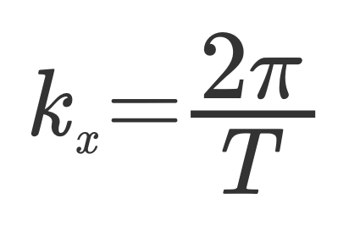
The Scalar theory of diffraction
Homework 1: consider the following scalar field
Evolve the field up to the distance z
Calculate the intensity. When evanescent waves start to appear? What are the physical consequences of this?

Slide 17
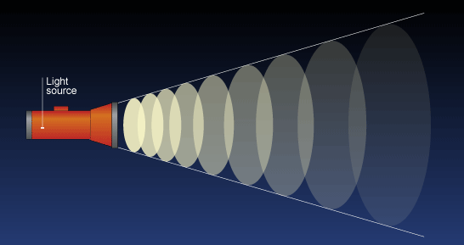
The Scalar theory of diffraction
Homework 2: According to visual experience, light sources (monochromatic or not), spread their content of energy during propagation more strongly if the region that emits light is more localized in space. Explain this phenomenon with the theory of diffraction

Slide 18
The Scalar theory of diffraction
References
M. Born and E. Wolf, Principle of Optics, Chapter 8.

