Slide 1
EE 231 Introduction to Optics
Scalar theory of diffraction
Lesson 7
Andrea Fratalocchi
www.primalight.org

Slide 2
The Scalar theory of diffraction
Homework 1: consider the following scalar field
Evolve the field up to the distance z
Calculate the intensity. When evanescent waves start to appear? What are the physical consequences of this?

Slide 3
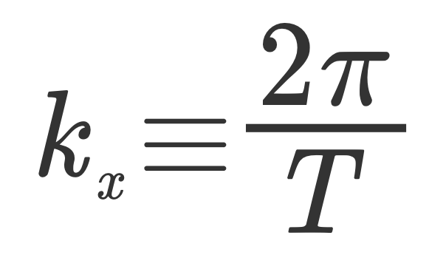
The Scalar theory of diffraction
Homework 1: consider the following scalar field
Evolve the field up to the distance z
We define
The field is composed by 2 plane waves

Slide 4
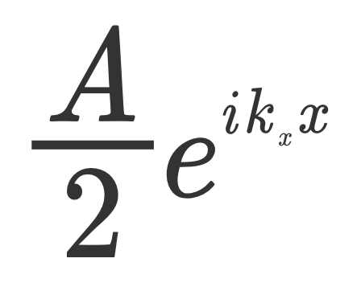
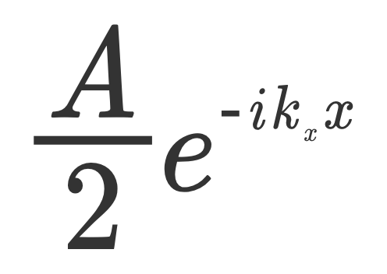
The Scalar theory of diffraction
We define
The field is composed by 2 plane waves

Slide 5
The Scalar theory of diffraction
We define
The field is composed by 2 plane waves
Calculate kz

Slide 6
The Scalar theory of diffraction
We define
The field is composed by 2 plane waves
Calculate kz
Evolve

Slide 7
The Scalar theory of diffraction
We define
Evolve
2) Calculate the intensity

Slide 8
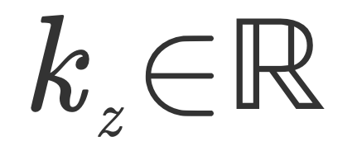
The Scalar theory of diffraction
We define
Evolve
2) Calculate the intensity
This implies
and
The intensity is a periodic pattern of fringes. (Homogeneous waves)

Slide 9
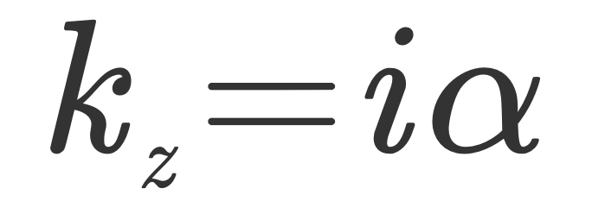
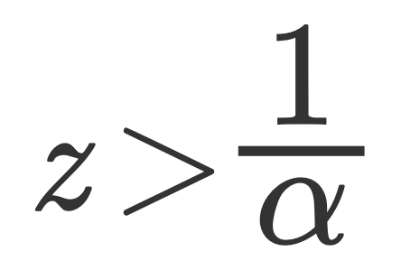
The Scalar theory of diffraction
We define
Evolve
2) Calculate the intensity
This implies
and
The intensity decays exponentially, after
The intensity I(x,z) reduces to 0. (Evanescent waves)

Slide 10
The Scalar theory of diffraction
How does this relates to imaging resolution?

Slide 11
The Scalar theory of diffraction
A first interaction problem
Incoming plane wave
Emerging scalar field
If
If
I do not see the object!
I see the object

Slide 12
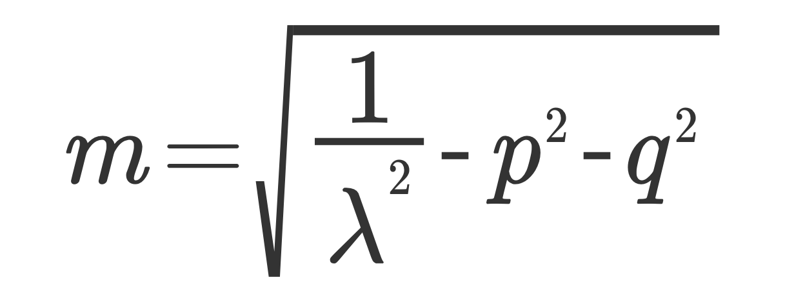
The Scalar theory of diffraction
The propagation problem
We can simplify the propagator by moving to spherical waves

Slide 13
The Scalar theory of diffraction
The propagation problem
With this position we have

Slide 14
The Scalar theory of diffraction
The propagation problem
With this position we have

Slide 15
The Scalar theory of diffraction
The propagation problem
With this position we have
By equating these two terms

Slide 16
The Scalar theory of diffraction
The propagation problem
We obtain:
Expression of the propagator in spherical waves
Much more compact
No integrals
Exact expression

Slide 17
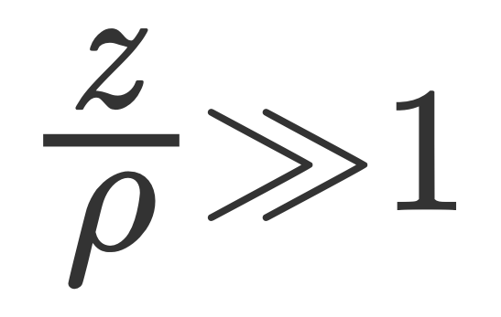
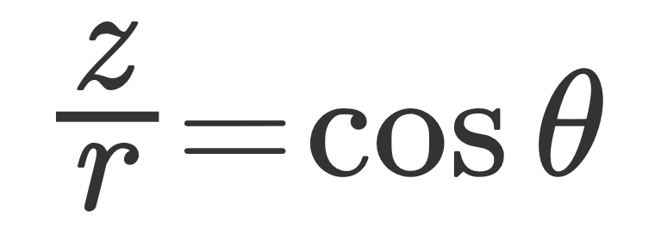
The Scalar theory of diffraction
The propagation problem
We obtain:
Paraxial approximation

Slide 18
The Scalar theory of diffraction
The propagation problem
We obtain:
Paraxial approximation
Is this expression familiar?

Slide 19
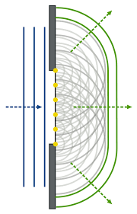
The Scalar theory of diffraction
The propagation problem
Huygens principle

Slide 20
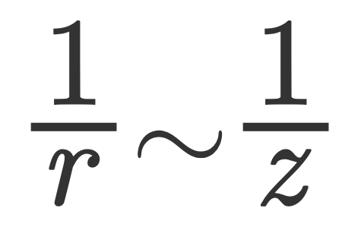
The Scalar theory of diffraction
The propagation problem
In paraxial regime, we can approximate the propagator even further

Slide 21
The Scalar theory of diffraction
The propagation problem
In paraxial regime, we can approximate the propagator even further
By substituting these approximations, we obtain Fresnel Diffraction Formula

Slide 22
The Scalar theory of diffraction
The propagation problem
Fresnel Diffraction Formula
If the distance z is further increased to large values, we have:

Slide 23
The Scalar theory of diffraction
The propagation problem
Far Field diffraction formula
If the distance z is further increased to large values, we have:

Slide 24
The Scalar theory of diffraction
The propagation problem
Far Field diffraction formula
The optical intensity "visualizes" a rescaled version of the Fourier Transform of the input field!

Slide 25
The Scalar theory of diffraction
The propagation problem
Exact propagator
Fresnel diffraction formula
Far-Field diffraction formula

Slide 26
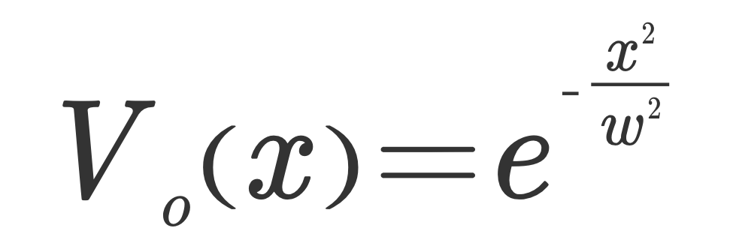
The Scalar theory of diffraction
Homework 1: study the elementary double slit experiment with the results of the previous analysis
Experimentally measured far-field intensity
Homework 2: calculate the far-field expression of the following input field:

Slide 27
The Scalar theory of diffraction
References
J. D. Jackson, Classical Electrodynamics, Chapter 10.
M. Born and E. Wolf, Principle of Optics, Chapter 8.
H. Haus, Waves and Fields in Optoelectronics, Chapter 2.

