Slide 1
EE 231 Introduction to Optics
Scalar theory of diffraction
Lesson 13
Andrea Fratalocchi
www.primalight.org

Slide 2
Hands on real cases: Application of diffraction theory
Rules and regulations
The class is divided into 3 teams
Each team is in competition with the others
Use of internet and other online resources is not allowed
Books are not allowed, only copy of the electronics notes
The activity is organized in II main modules, each module has a score from 1 to 10 and should be completed on 1, maximum 2, A4 pages.
Justify all assumptions and approximations used.
Each team can send a single "preview" of the solution of each module. The preview is quickly assessed and errors/inconsistencies are marked for revision.
In each module, each member of the team can examine the various elements allowed to be used in the experiment
At the end of the 2nd module, the winning team performs the experiment and acquires the data for the lab report, which has to be completed individually by each member of the team

Slide 3
The Scalar theory of diffraction
Hands on real cases: Application of diffraction theory
Part I (5 min)
142821 Congli Wang (Team A)
149353 Ronghui Lin (Team B)
142765 Qilin Sun (Team C)

Slide 4
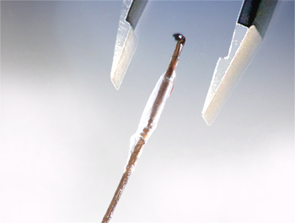
The Scalar theory of diffraction
Hands on real cases: Application of diffraction theory
The Problem: you are required to design an experiment to measure the thickness of a sub mm object, such as a human hair

Slide 5
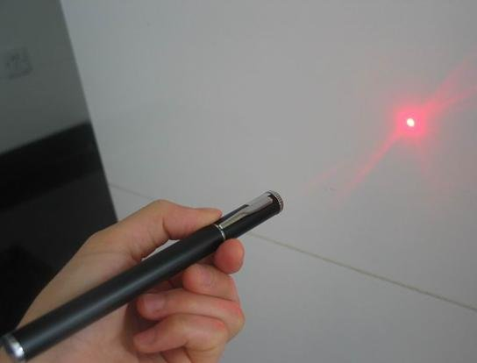
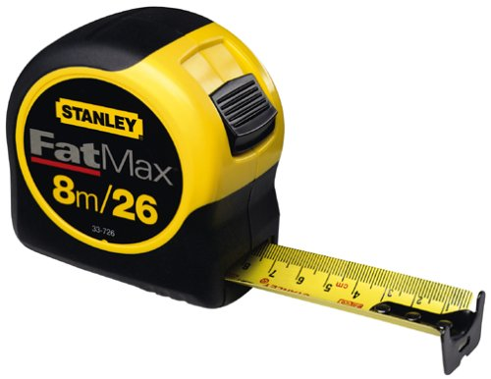
The Scalar theory of diffraction
Hands on real cases: Application of diffraction theory
The Problem: you are required to design an experiment to measure the thickness of a sub mm black object, such as a human hair
Elements you can use
Laser
Metric tape

Slide 6
The Scalar theory of diffraction
Hands on real cases: Application of diffraction theory
Module I (25 min)
Design the experiment, including:
The setup
The theoretical analysis of light propagation and input-output relations of the observables used to measure the thickness
The formula expressing the thickness as a function of the observables

Slide 7
The Scalar theory of diffraction
Hands on real cases: Application of diffraction theory
Module II (30 min)
Evaluate the uncertainty of your measurement procedure, including:
Express all the possible sources of uncertainty in your measure, and characterize their nature (type A or type B following NIST guidelines)
Evaluate the standard uncertainty of each separate component
Evaluate the combined uncertainty of your measure
Is there space for improvement?

