Slide 1
EE 231 Introduction to Optics
Scalar theory of diffraction
Lesson 6
Andrea Fratalocchi
www.primalight.org

Slide 2
The Scalar theory of diffraction
Homework 1: how to experimentally generate a Bessel beam?

Slide 3
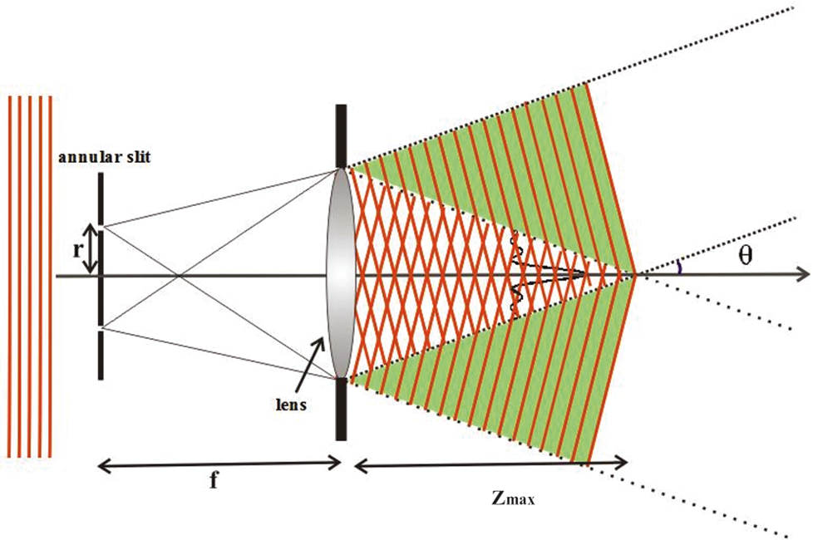
The Scalar theory of diffraction
Homework 1: how to experimentally generate a Bessel beam?
We can use annular slit that generates spherical waves from an impinging planar wavefront and a lens that transforms spherical waves into a bessel beam

Slide 4
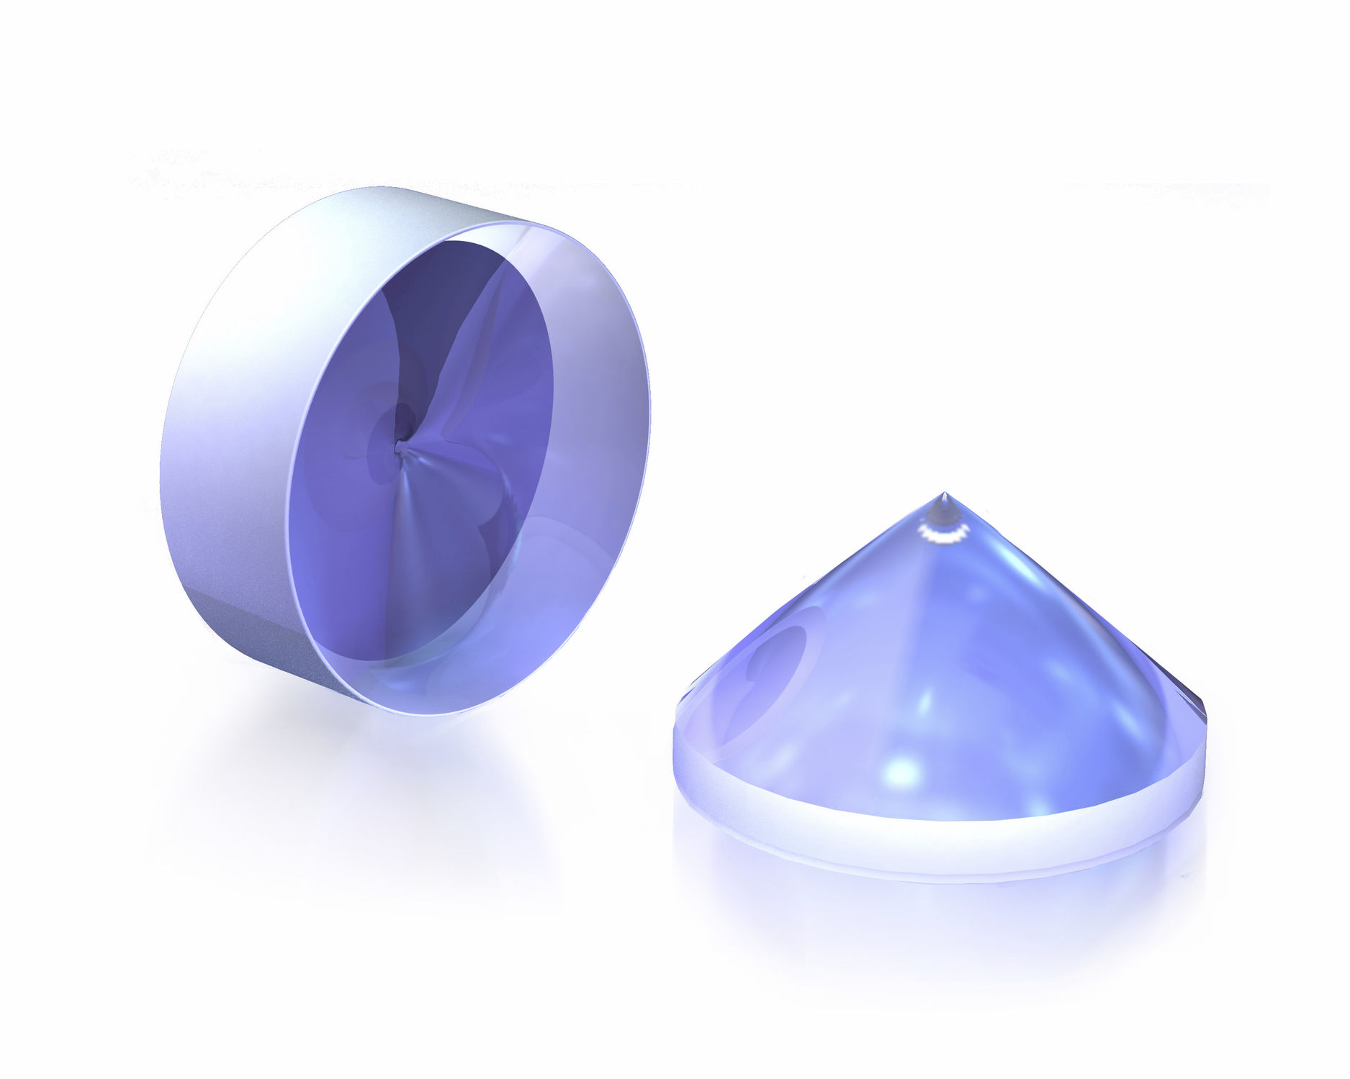
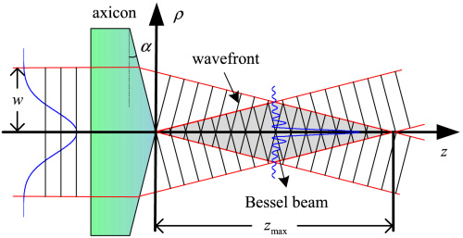
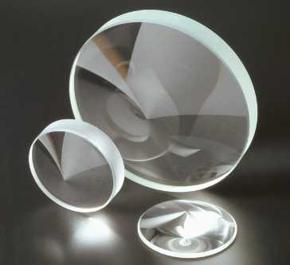
The Scalar theory of diffraction
Homework 1: how to experimentally generate a Bessel beam?
Use axicon lenses

Slide 5
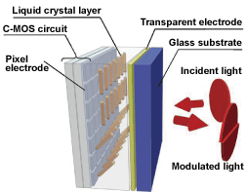
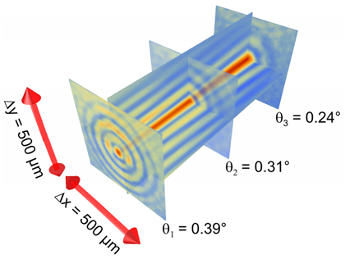
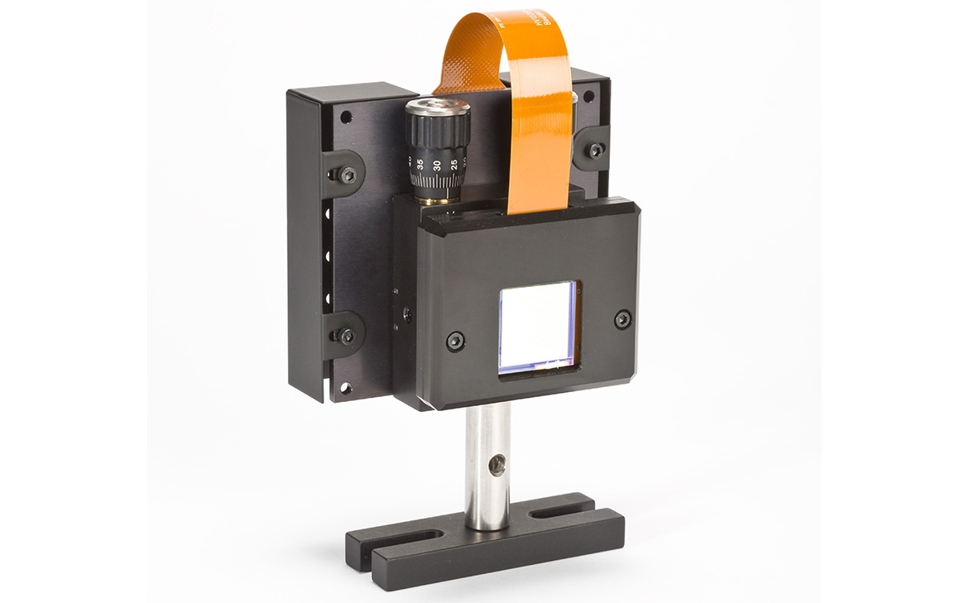
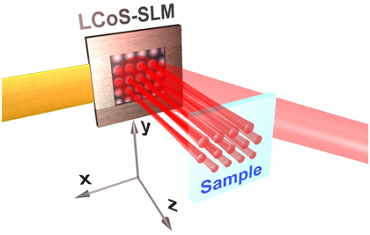
The Scalar theory of diffraction
Homework 1: how to experimentally generate a Bessel beam?
Use of spatial light modulators

Slide 6
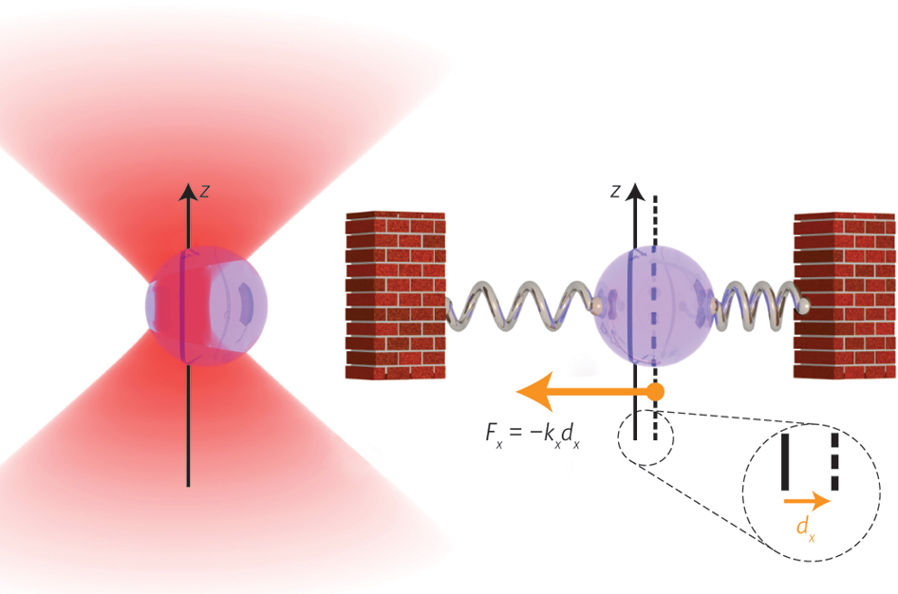
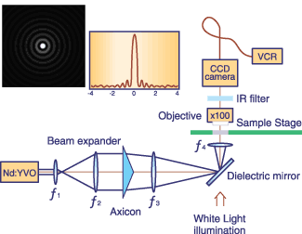
The Scalar theory of diffraction
Homework 3: can you think of some possible applications of Bessel beams?
Optical tweezers

Slide 7
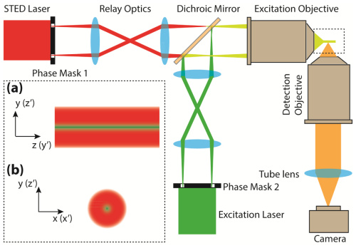
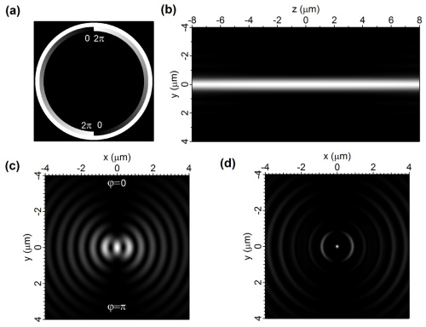
The Scalar theory of diffraction
Homework 3: can you think of some possible applications of Bessel beams?
Super-resolution imaging

Slide 8
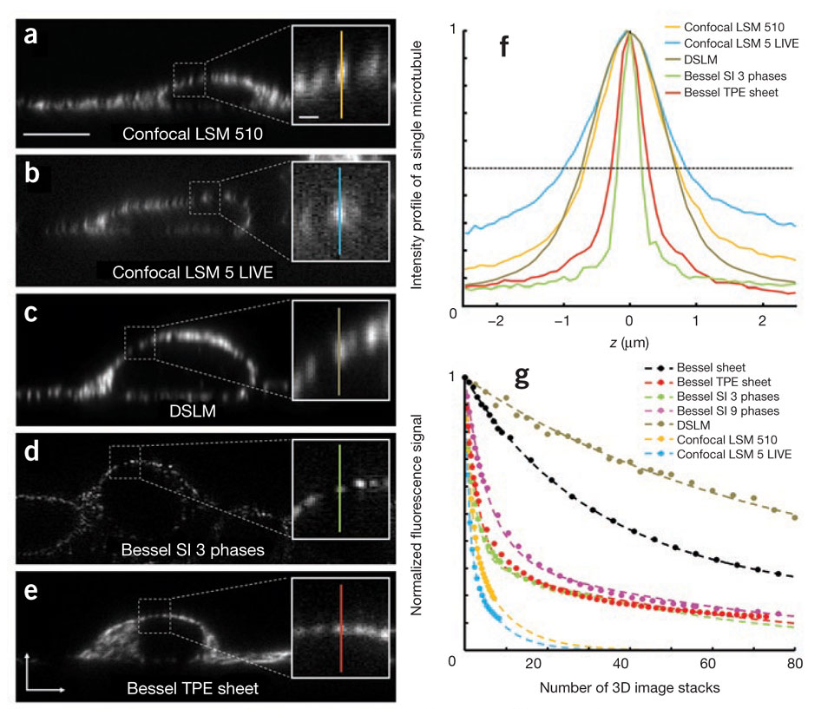
The Scalar theory of diffraction
Homework 3: can you think of some possible applications of Bessel beams?
Nature Methods 8, 417–423 (2011)

Slide 9
The Scalar theory of diffraction
Elements of linear system theory and normal mode decomposition
Superposition principle

Slide 10
The Scalar theory of diffraction
Elements of linear system theory and normal mode decomposition
Translational invariance

Slide 11
The Scalar theory of diffraction
Elements of linear system theory and normal mode decomposition
Superposition + translational invariance:

Slide 12
The Scalar theory of diffraction
Elements of linear system theory and normal mode decomposition
Superposition + translational invariance:

Slide 13
The Scalar theory of diffraction
Elements of linear system theory and normal mode decomposition
Superposition + translational invariance:
By defining the impulse response
The impulse response is also known as Green function in the theory of differential equations

Slide 14
The Scalar theory of diffraction
Elements of linear system theory and normal mode decomposition
Superposition + translational invariance:
By defining the impulse response

Slide 15
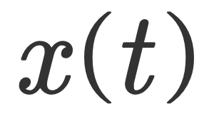
The Scalar theory of diffraction
Elements of linear system theory and normal mode decomposition
Sum up
Decompose
Propagate

Slide 16
The Scalar theory of diffraction
The Fourier transform
The Fourier transform decomposes a field into its constituent frequency components

Slide 17
The Scalar theory of diffraction
The Fourier transform
Decompose
Decompose

Slide 18
The Scalar theory of diffraction
Homework 1: given the generic expansion:
Calculate the coefficients X
Hint: start from the discrete series expansion
And use the scalar product between the functions of the expansion

Slide 19
The Scalar theory of diffraction
References
Any textbook on linear algebra and calculus
D. McGloin, K. Dholakia, Bessel beams: diffraction in a new light, Contemporary Physics 46 (2005) 15-28. https://www.phys.ksu.edu/reu2014/joshuanelson/BesselBeam1.pdf

