Slide 1
EE 231 Introduction to Optics
Scalar theory of diffraction
Lesson 9
Andrea Fratalocchi
www.primalight.org

Slide 2
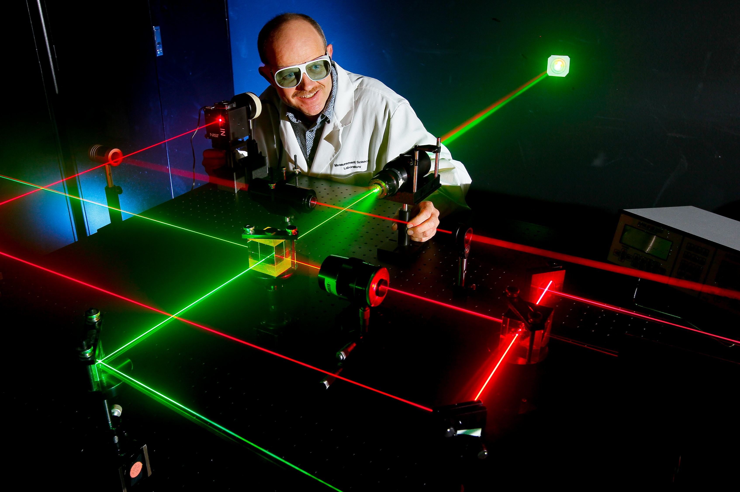
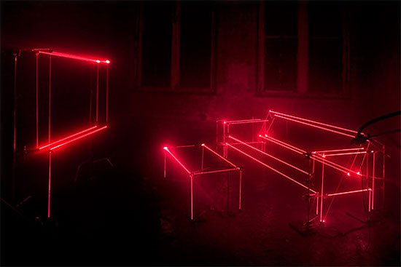
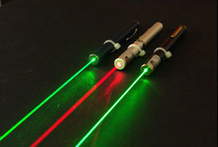
The Scalar theory of diffraction
Analysis of laser beams
How to model laser light as an electromagnetic wave?

Slide 3
The Scalar theory of diffraction
How to model laser light as an electromagnetic wave?
Being an electromagnetic wave, it follows from Maxwell equations
Main properties of laser light:

Slide 4
The Scalar theory of diffraction
How to model laser light as an electromagnetic wave?
Being an electromagnetic wave, it follows from Maxwell equations
Main properties of laser light:
Localized intensity distribution along the transverse plane
Weak spreading of light energy upon propagation

Slide 5
The Scalar theory of diffraction
How to model laser light as an electromagnetic wave?
Weak spreading of light energy upon propagation
Why light spreads, or diffracts, its energy on propagation?
The smaller the source, the higher the spreading

Slide 6
The Scalar theory of diffraction
Why light spreads, or diffracts, its energy on propagation?
This is a propagation problem

Slide 7
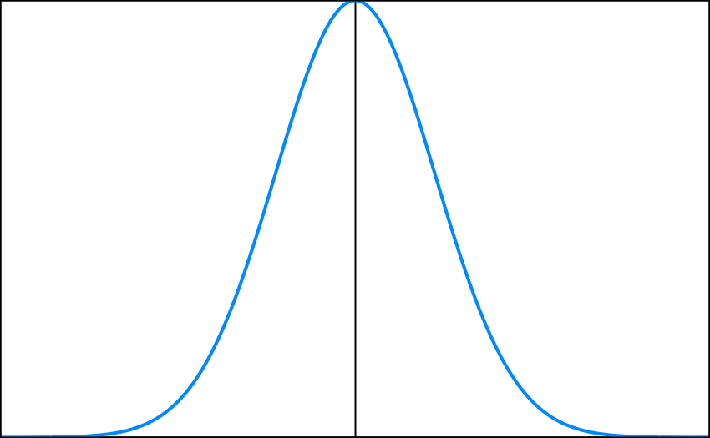
The Scalar theory of diffraction
Why light spreads, or diffracts, its energy on propagation?
This is a propagation problem

Slide 8
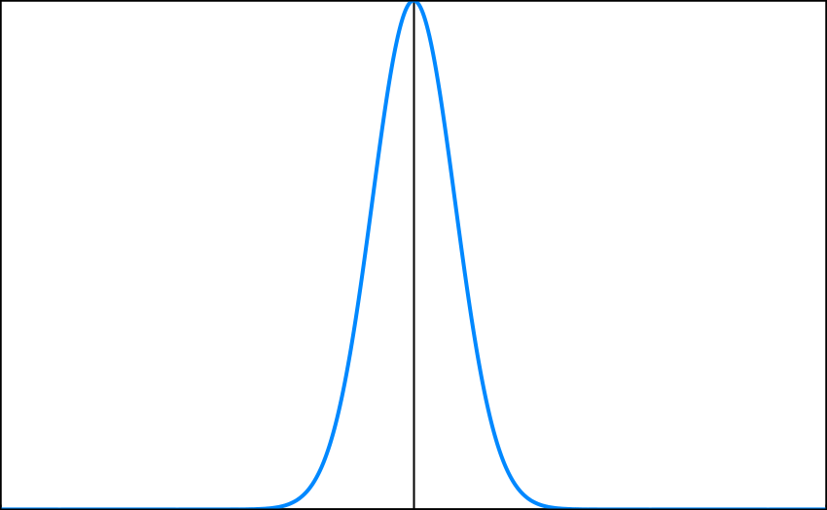
The Scalar theory of diffraction
Why light spreads, or diffracts, its energy on propagation?
This is a propagation problem

Slide 9
The Scalar theory of diffraction
Why light spreads, or diffracts, its energy on propagation?

Slide 10
The Scalar theory of diffraction
Why light spreads, or diffracts, its energy on propagation?

Slide 11
The Scalar theory of diffraction
Why light spreads, or diffracts, its energy on propagation?
It depends on the dispersion relation and, at such, is a general feature of all beams that propagate in homogeneous materials

Slide 12
The Scalar theory of diffraction
Why light spreads, or diffracts, its energy on propagation?
Question: why Bessel beams do not diffract then?

Slide 13
The Scalar theory of diffraction
Why light spreads, or diffracts, its energy on propagation?
Question: why Bessel beams do not diffract then?
Answer: because they are characterized by a field that extends in space from –infinite to +infinite. This is an idealized condition that can never be realized in practice. This implies that, as seen, we can generate these solutions only on finite propagation distances.

Slide 14
The Scalar theory of diffraction
How to model laser light as an electromagnetic wave?
Being an electromagnetic wave, it follows from Maxwell equations
Main properties of laser light:
Localized intensity distribution along the transverse plane
Weak spreading of light energy upon propagation
This implies that laser light is a suitable combination of waves that minimize this effect

Slide 15
The Scalar theory of diffraction
Being an electromagnetic wave, it follows from Maxwell equations
Localized intensity distribution along the transverse plane
Weak spreading of energy
Helmholtz equation
We look for solutions of the type:
By substituting into Helmholtz eq.

Slide 16
The Scalar theory of diffraction
Being an electromagnetic wave, it follows from Maxwell equations
Localized intensity distribution along the transverse plane
Weak spreading of energy Slowly varying envelope
With this position, we get:
Paraxial wave equation
Question: did you see this equation in another context before?

Slide 17
The Scalar theory of diffraction
Being an electromagnetic wave, it follows from Maxwell equations
Localized intensity distribution along the transverse plane
Weak spreading of energy Slowly varying envelope
With this position, we get:
Paraxial wave equation
Question: did you see this equation in another context before?

Slide 18
The Scalar theory of diffraction
Being an electromagnetic wave, it follows from Maxwell equations
Localized intensity distribution along the transverse plane
Weak spreading of energy Slowly varying envelope
Paraxial wave equation

Slide 19
The Scalar theory of diffraction
Homework 1: by using two thin lenses of focal length f1 and f2, design by using the ABCD ray matrices a beam expander and calculate the magnification ratio M:
Beam expander

Slide 20
The Scalar theory of diffraction
References
A. Yariv, Optical electronics in modern communications, Chapter 2.

