Slide 1
EE 231 Introduction to Optics
Review of basic EM concepts
Lesson 1
Andrea Fratalocchi
www.primalight.org

Slide 2
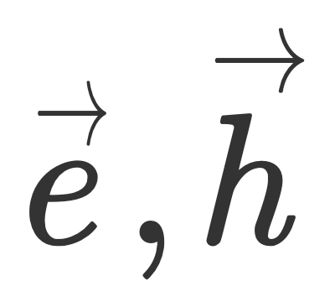
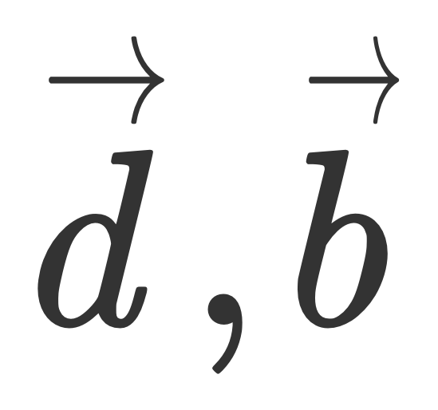
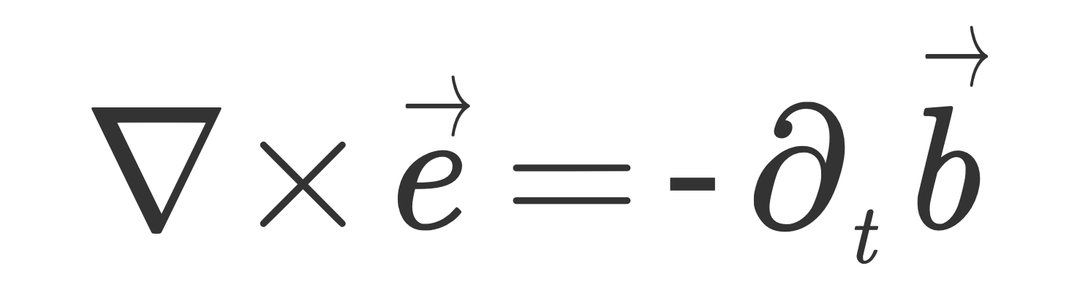
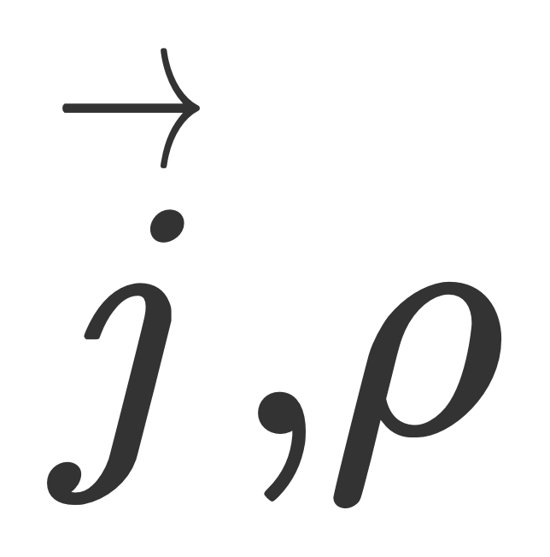
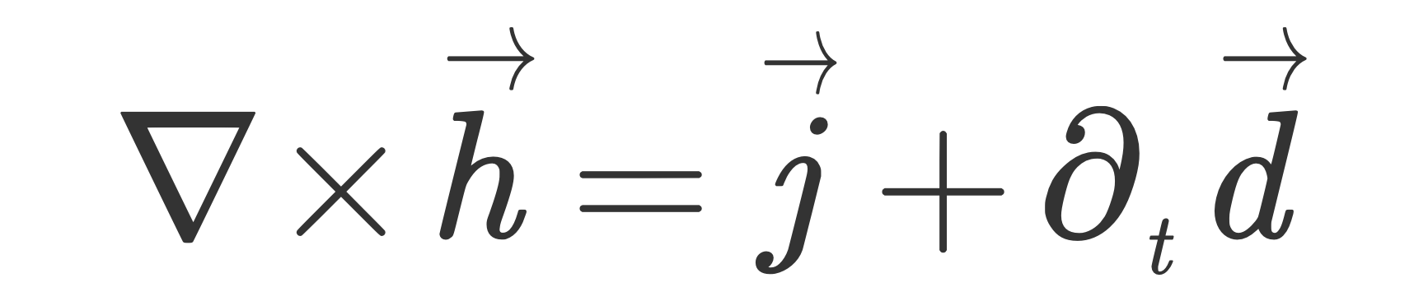
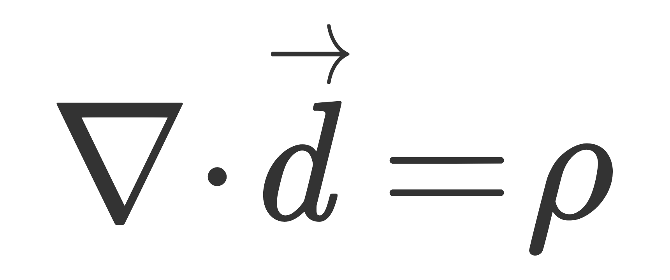
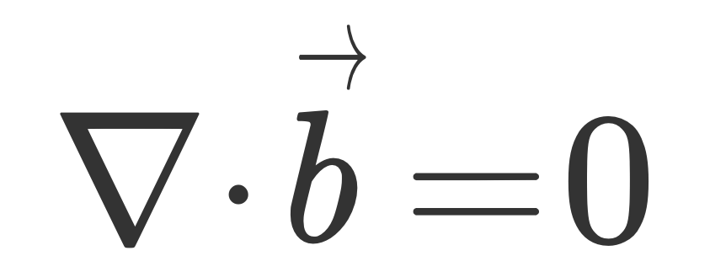
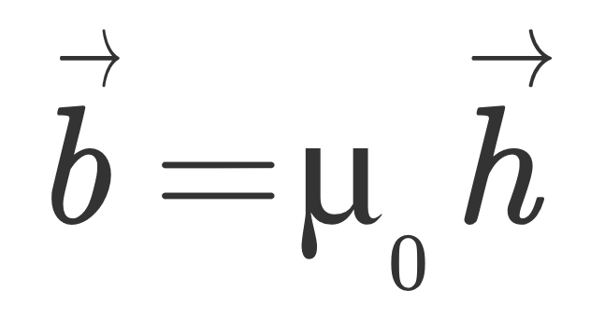
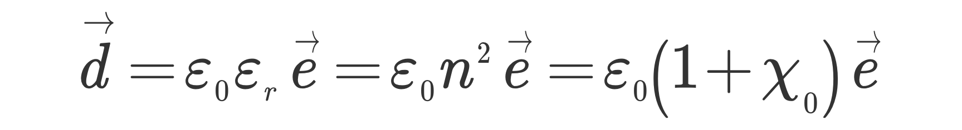
Light matter interactions in isotropic and homogeneous media
EM Field
Maxwell Equations
Material response
EM sources
Constitutive relations

Slide 3
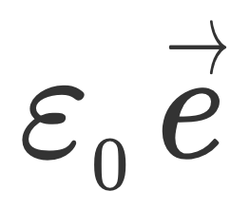
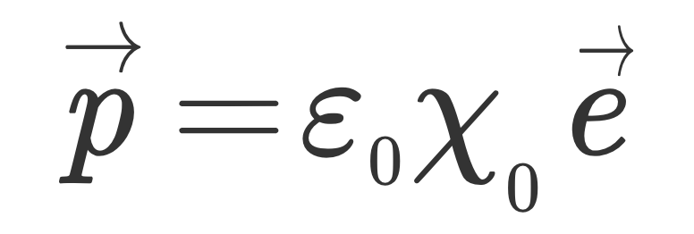
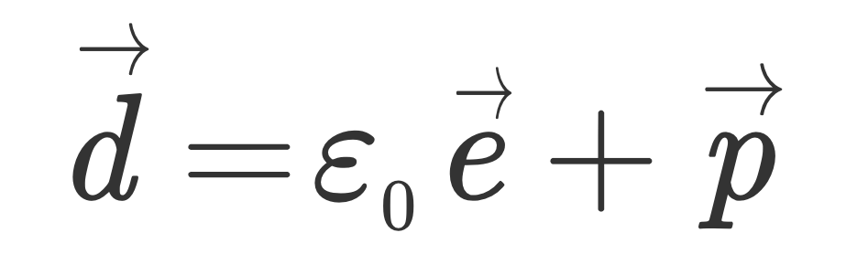






Light matter interactions in isotropic and homogeneous media
Constitutive relations
Magnetic constant
Refractive index
Permittivity
Susceptibility
Dielectric constant
Material polarization
Material response
Input field

Slide 4
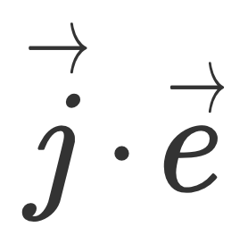
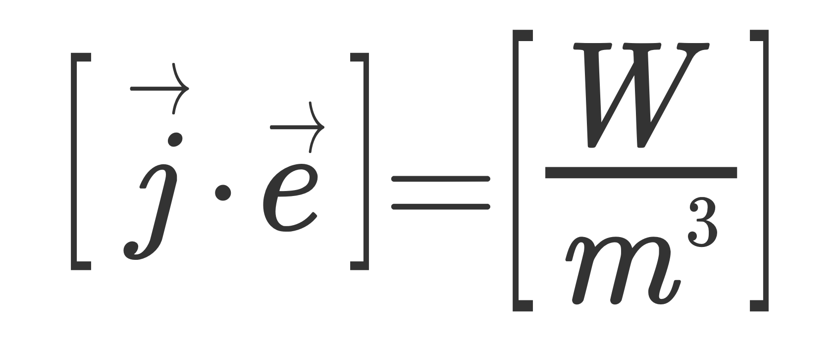
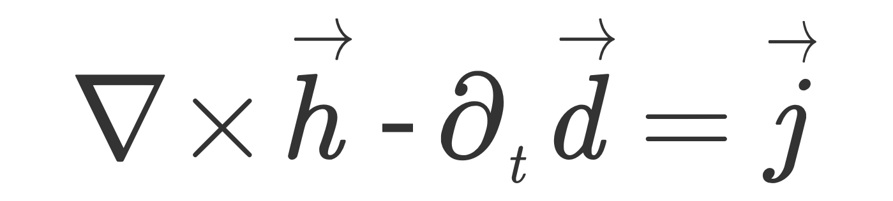
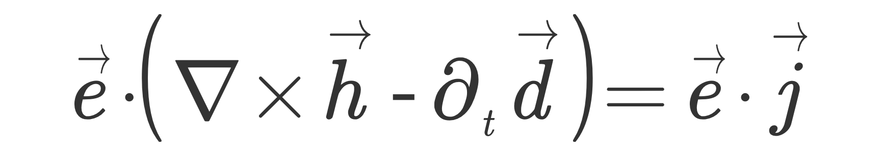
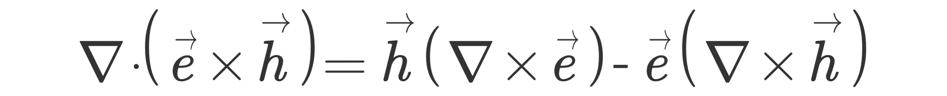
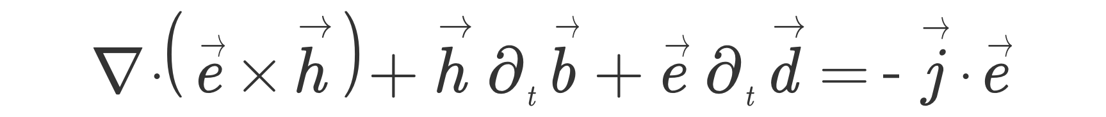
Light matter interactions in isotropic and homogeneous media
Work done by EM field x unit volume and x unit time
By using the vector identity
Poynting Theorem

Slide 5
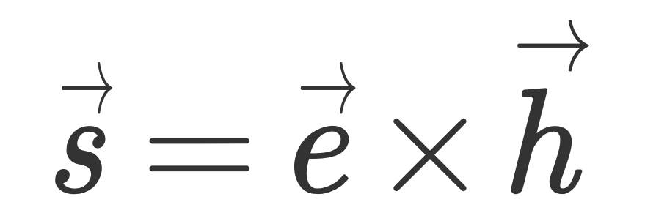
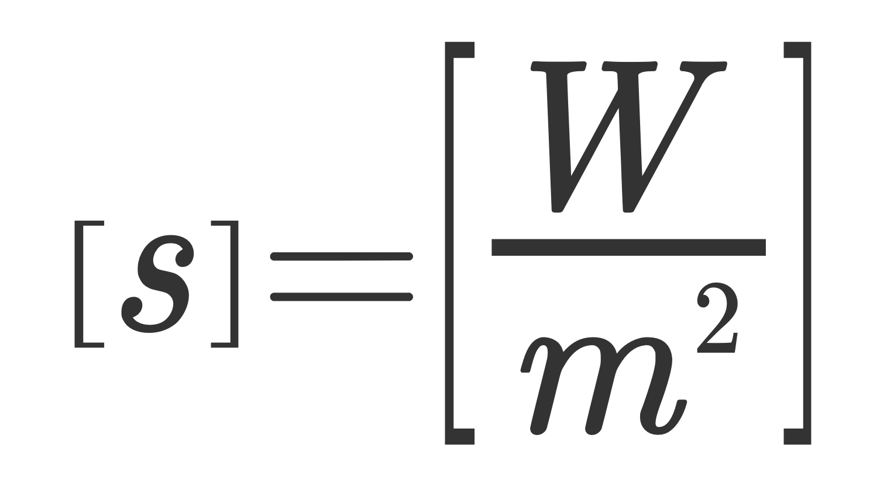
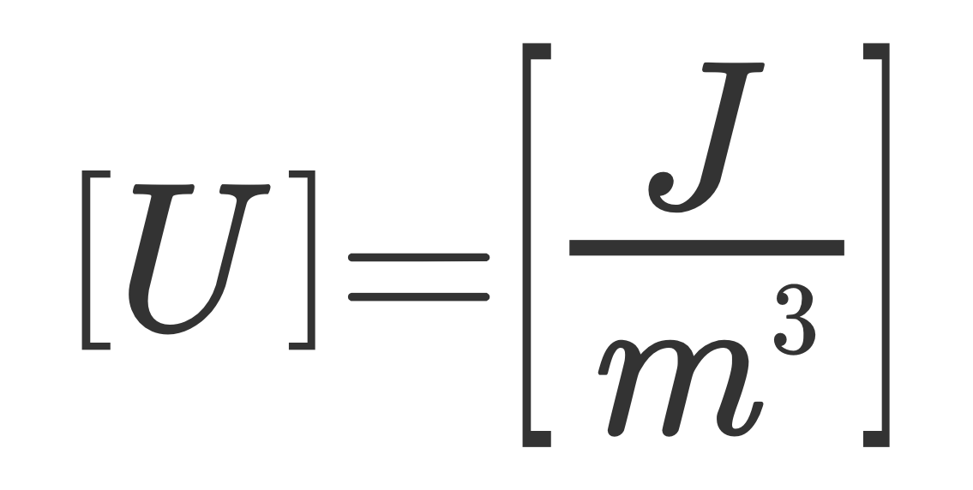
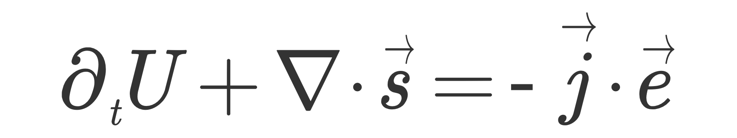





Light matter interactions in isotropic and homogeneous media
Poynting Theorem
Energy flux of EM field, or equivalently, power density x unit area is direction of
Energy density of the EM field
Energy conservation equation for EM field

Slide 6
Light matter interactions in isotropic and homogeneous media
Question: why energy is a fundamental quantity?

Slide 7
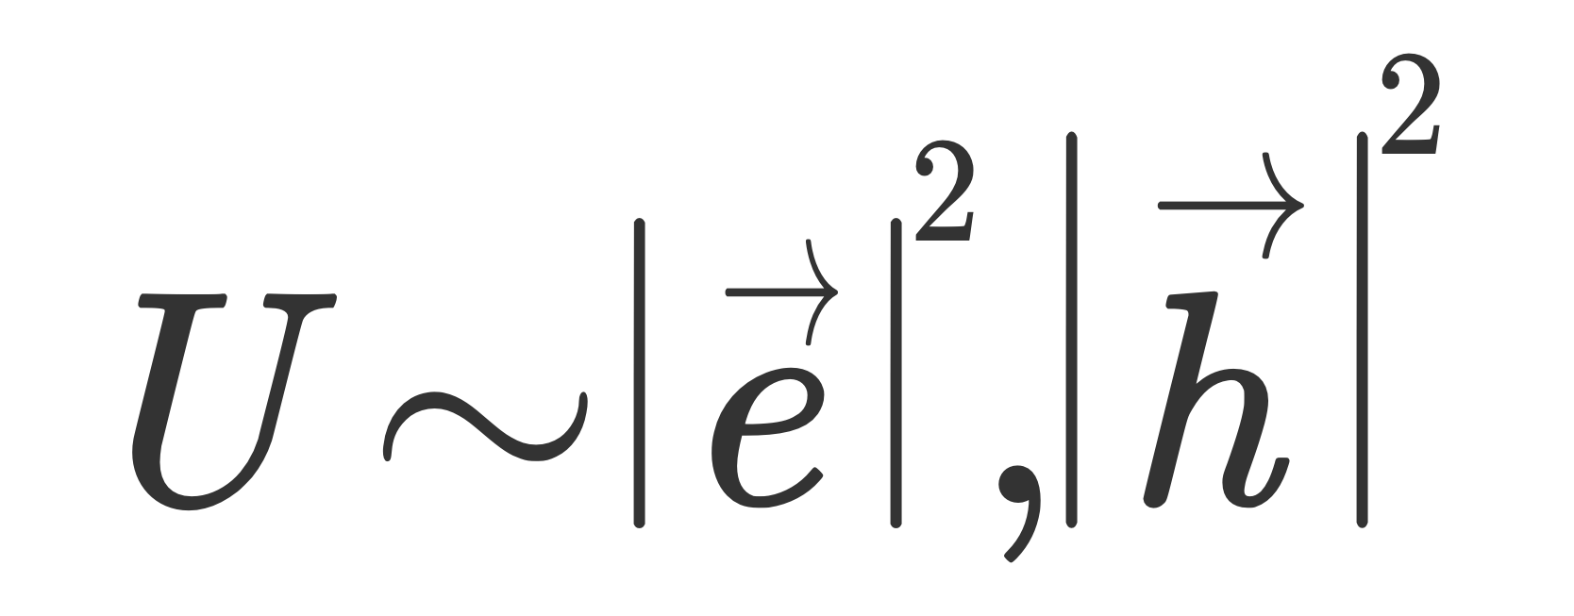
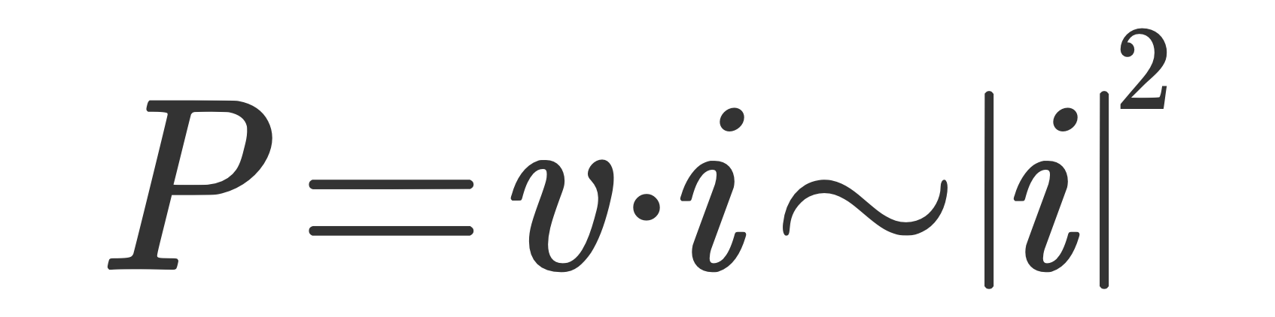
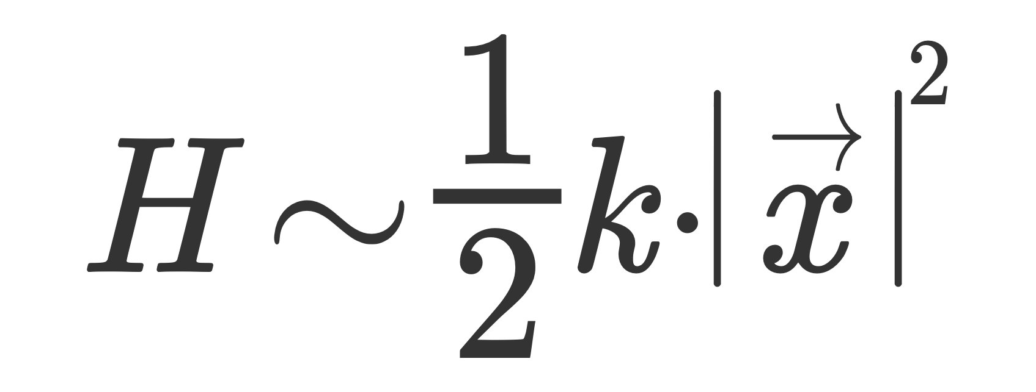

Light matter interactions in isotropic and homogeneous media
Question: why energy is a fundamental quantity?
Because is related to the concept of norm, which is related to the fundamental concept of "length":
This is a general result:
Power dissipated in circuits:
Energy of elastic system (e.g., spring):
Depends on the norm of the signal

Slide 8
Light matter interactions in isotropic and homogeneous media
Question: did you already encounter expressions of this type?

Slide 9
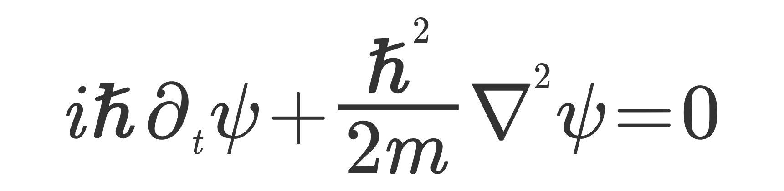
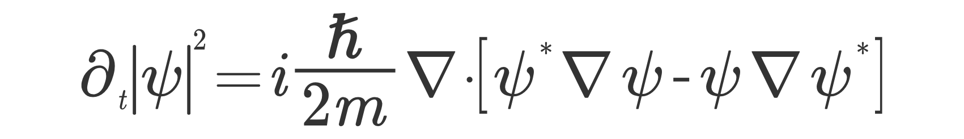
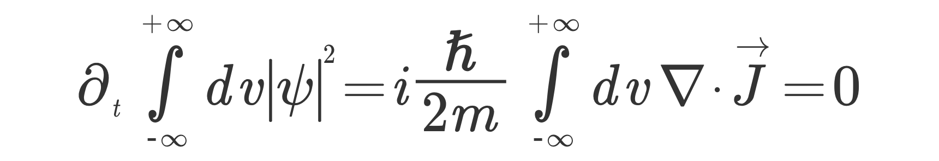
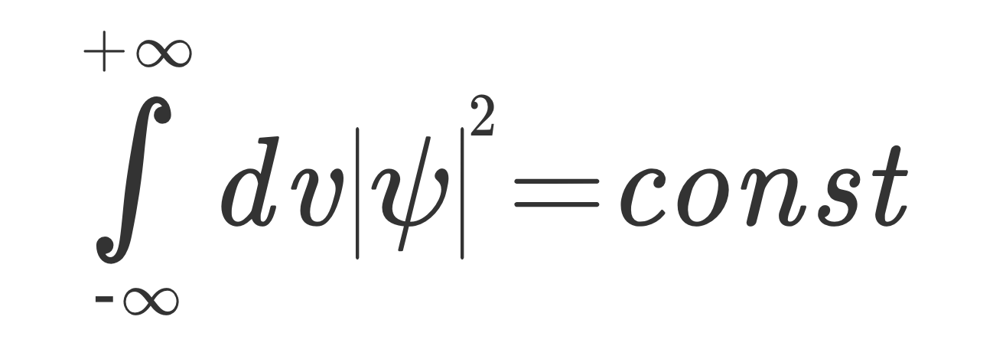
Light matter interactions in isotropic and homogeneous media
Question: did you already encounter expressions of this type?
Schroedinger equation of a free electron
Conservation of number of particles

Slide 10
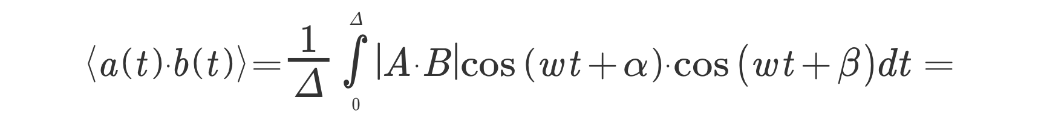
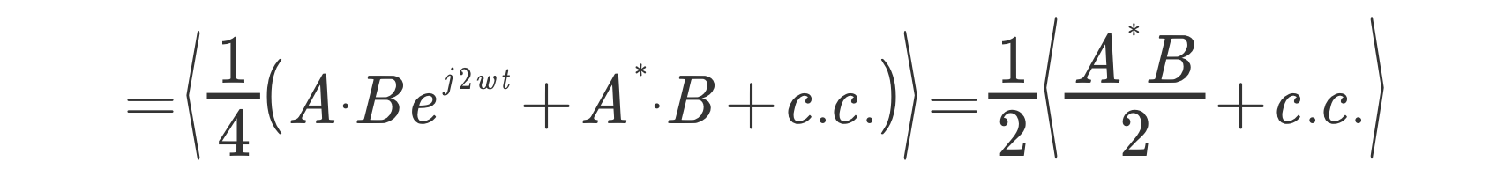
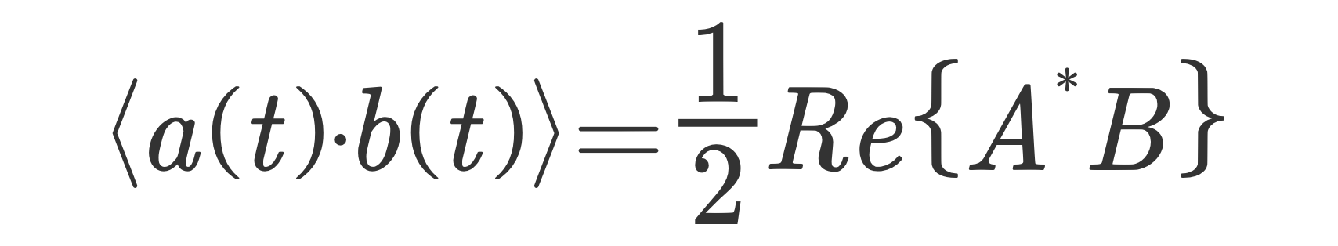



Light matter interactions in isotropic and homogeneous media
Complex formalism
Time average of complex functions

Slide 11
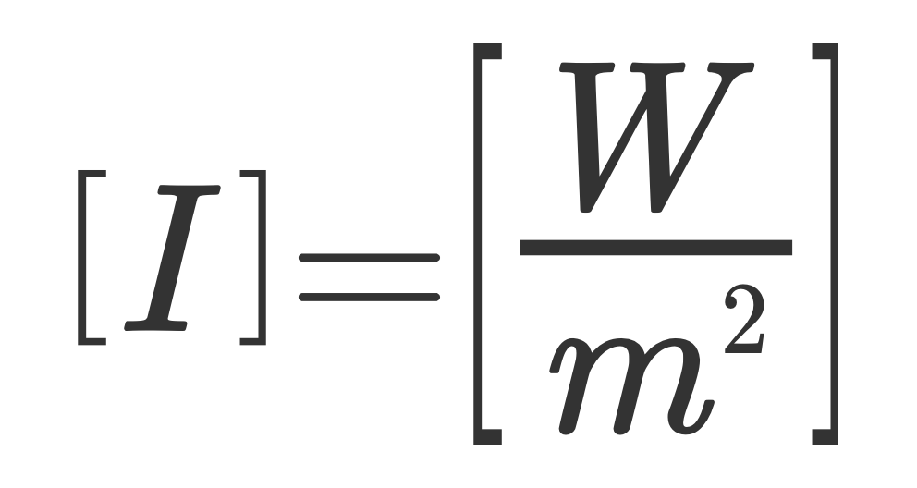
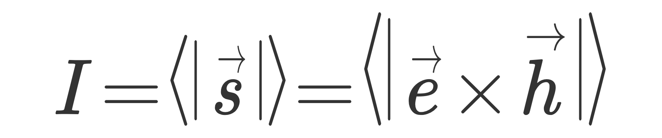
Light matter interactions in isotropic and homogeneous media
Optical Intensity
Average power x unit area carried by the EM field in the direction of propagation of the energy
The intensity is one of the most important optical quantity
In the complex formalism:
Exercise: demonstrate this relation
Question: why we use the intensity and not directly the EM field?

Slide 12
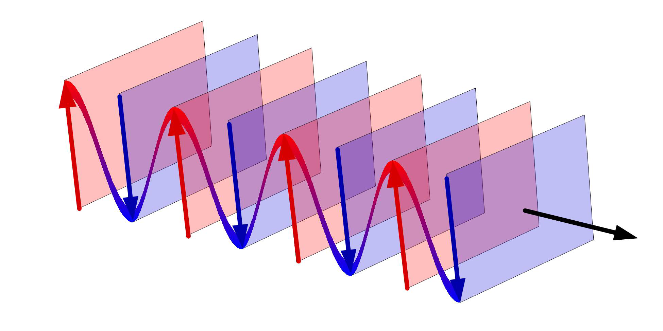
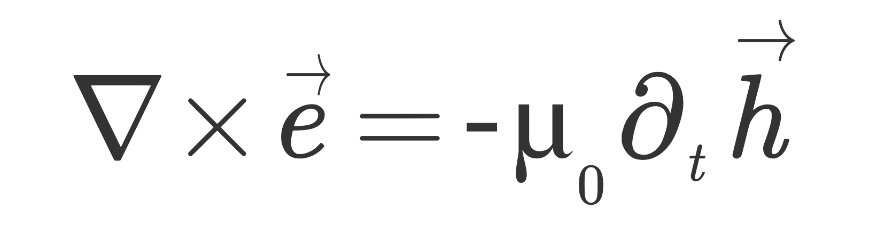
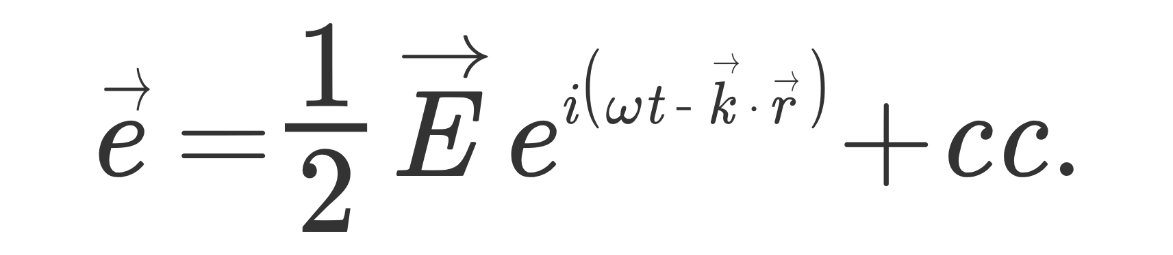
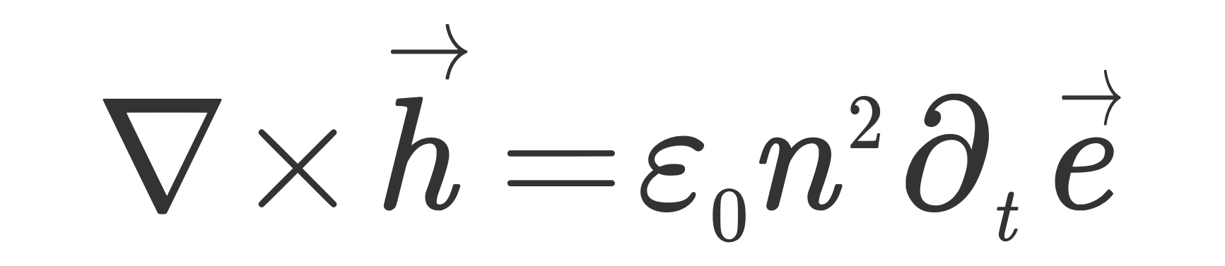
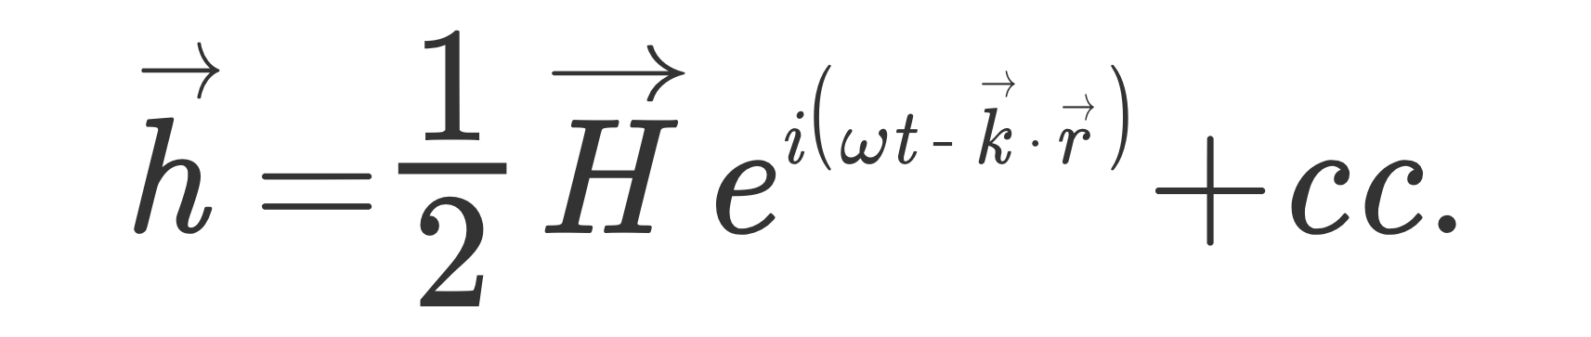
Light matter interactions in isotropic and homogeneous media
Plane waves
A harmonic plane wave is a constant-frequency wave whose wavefronts (surfaces of constant phase) are infinite parallel planes of constant peak-to-peak amplitude normal to the phase velocity vector.
Maxwell equations
Wave description of a plane wave

Slide 13
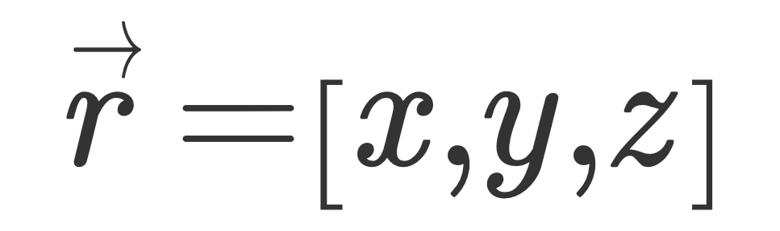
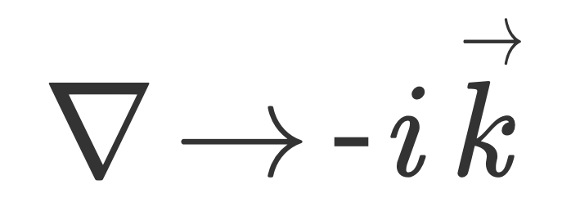
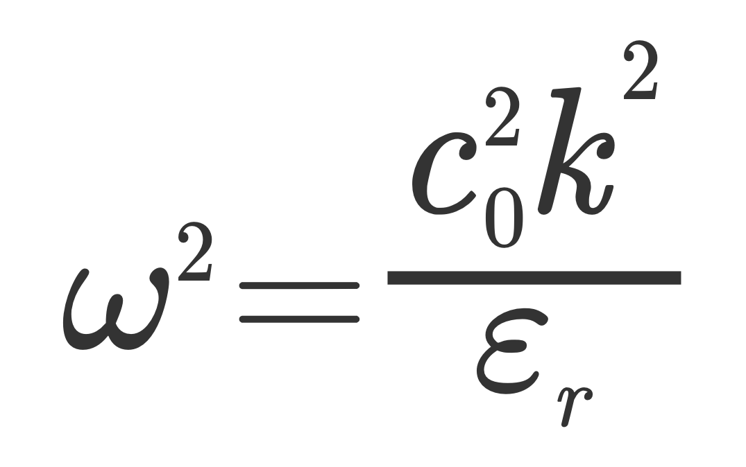

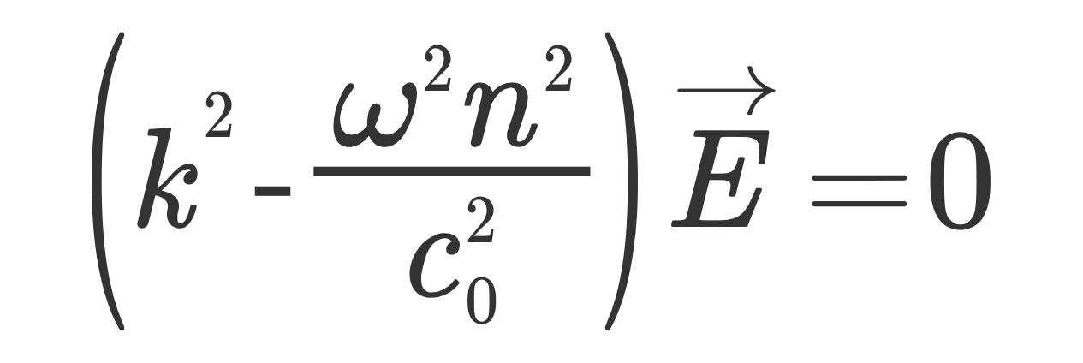

Light matter interactions in isotropic and homogeneous media
Maxwell equations
Wave description of a plane wave
Frequency
Wavevector
For a plane wave, we have
Dispersion relation
By substituting into Maxwell equations
Key quantity, this specific expression is valid only in isotropic and homogenous materials

Slide 14
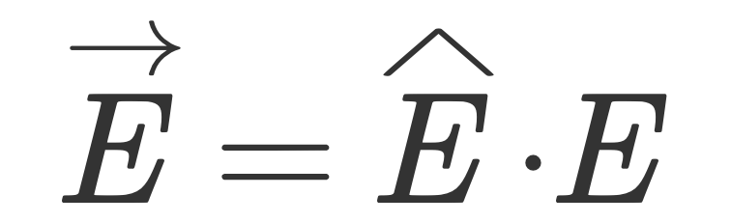
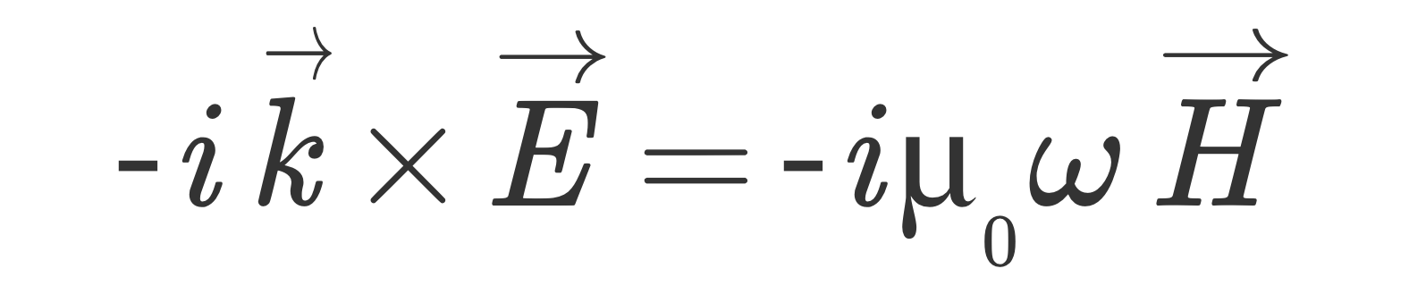
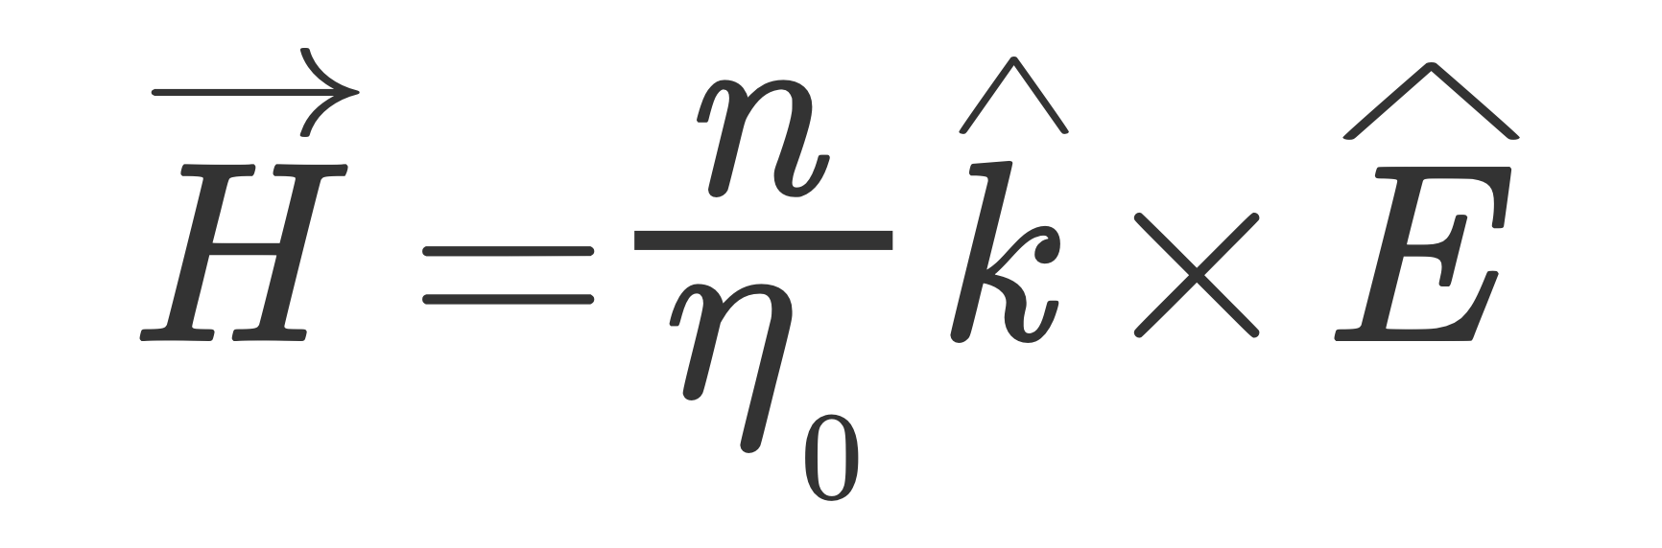
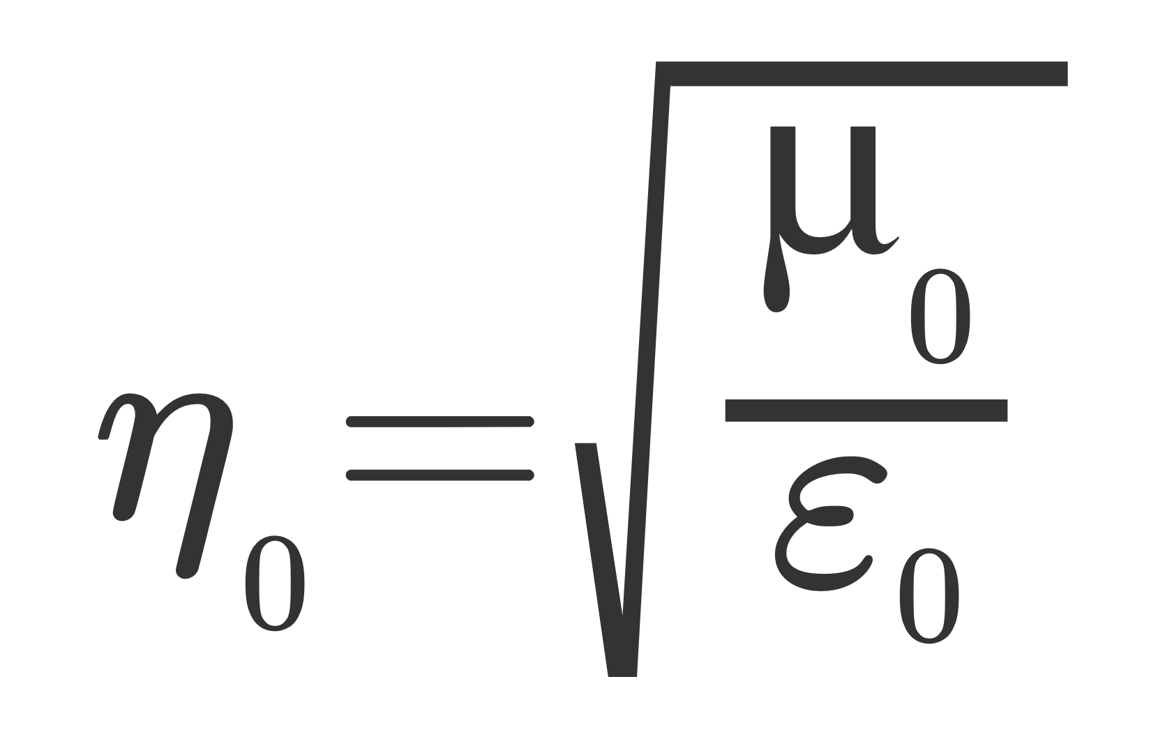
Light matter interactions in isotropic and homogeneous media
Maxwell equations
Wave description of a plane wave
Linearly polarized plane wave
From Maxwell equations
Vacuum impedance

Slide 15



Light matter interactions in isotropic and homogeneous media
Maxwell equations
Wave description of a plane wave
Exercise: demonstrate that the unit vectors of k, E, H are mutually orthogonal

Slide 16
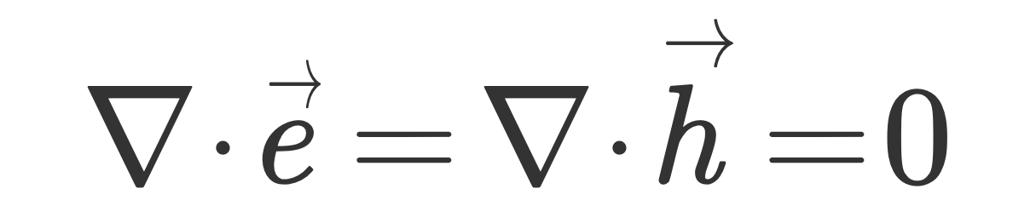
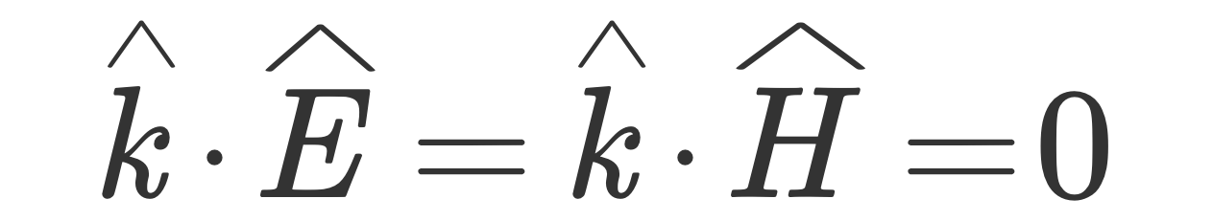

Light matter interactions in isotropic and homogeneous media
Maxwell equations
Wave description of a plane wave
Exercise: demonstrate that the unit vectors of k, E, H are mutually orthogonal
Is orthogonal to k and E

Slide 17
Light matter interactions in isotropic and homogeneous media
Maxwell equations
Wave description of a plane wave
Exercise calculate the direction and the norm of the Poynting vector

Slide 18
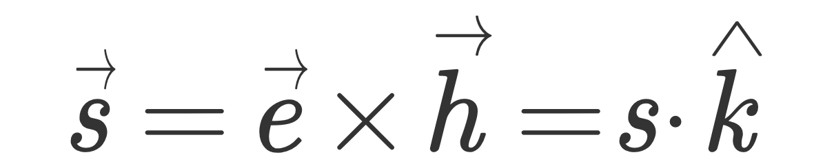


Light matter interactions in isotropic and homogeneous media
Maxwell equations
Wave description of a plane wave
Exercise calculate the direction and the norm of the Poynting vector
The direction of the energy is parallel to the wave vector. This is NOT a general property of plane waves, and is valid only in isotropic media

Slide 19

Light matter interactions in isotropic and homogeneous media
Homework 1:
You are studying the emission of a unknown type of optical source. From your analysis, the field emission from the source is characterized by the following time dependent waveform:
With arbitrary N integer. How many different colors are contained in such optical field?
(Hint: start by plotting and analyzing the field profile for different N)

Slide 20
Light matter interactions in isotropic and homogeneous media
Homework 2:
Demonstrate this relationship:

Slide 21
Light matter interactions in isotropic and homogeneous media
Homework 3:
Expand the following expression into simple exponentials:

Slide 22
Light matter interactions in isotropic and homogeneous media
References
A. Yariv, Optical electronics in modern communication, 6th Edition, Chapter 1
Any textbook of classical EM theory

