Slide 1
EE 231 Introduction to Optics
Geometrical optics and Imaging theory
lesson 2
Andrea Fratalocchi
www.primalight.org

Slide 2
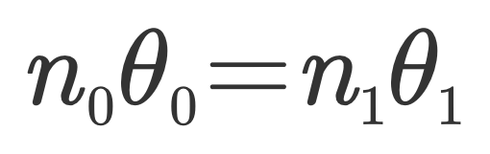
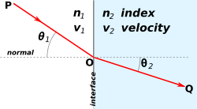
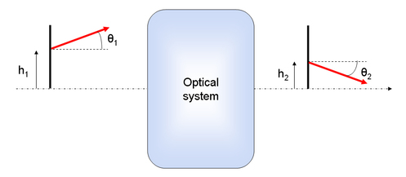
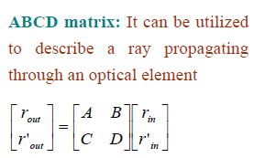
Matrix Optics
Matrix Optics is a powerful technique to trace rays in paraxial approximation. It is based on the fact that Snell law in paraxial approximation is linear:

Slide 3
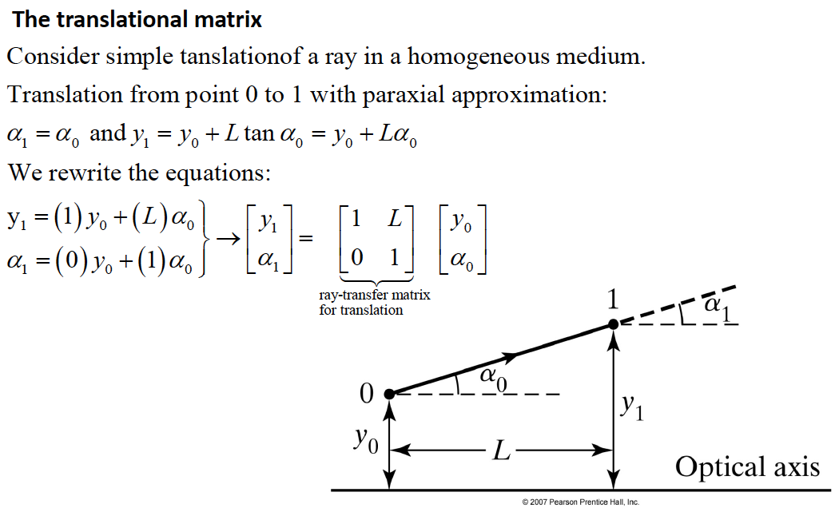
Matrix Optics

Slide 4
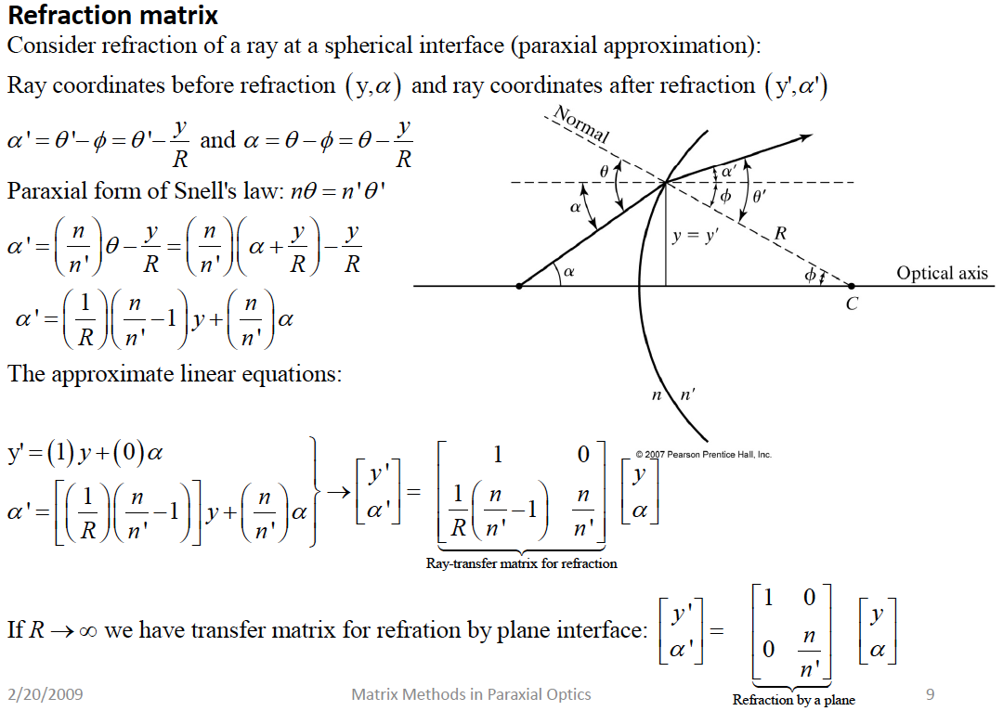

Slide 5
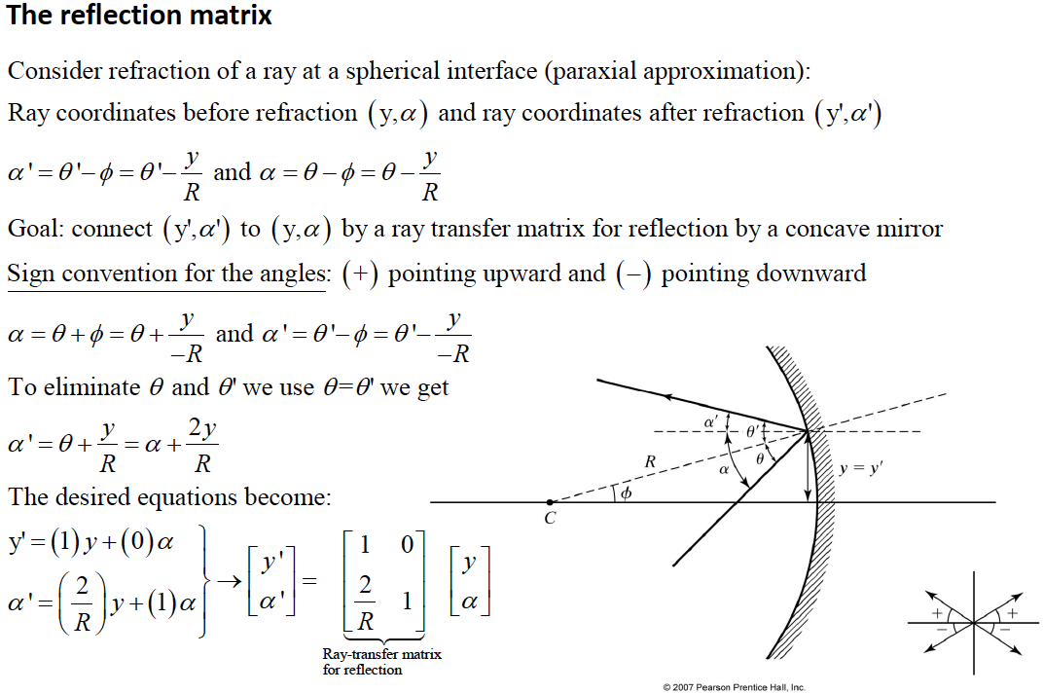

Slide 6
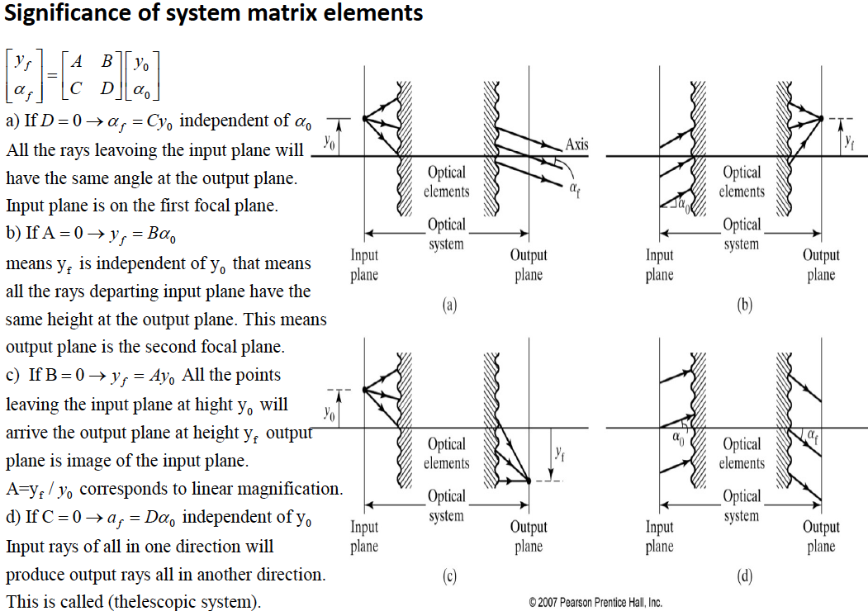

Slide 7
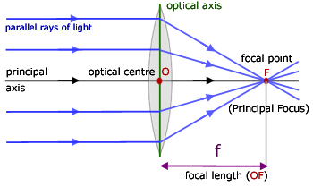
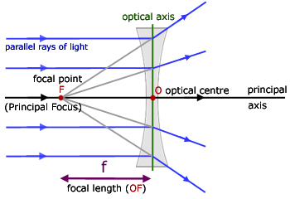
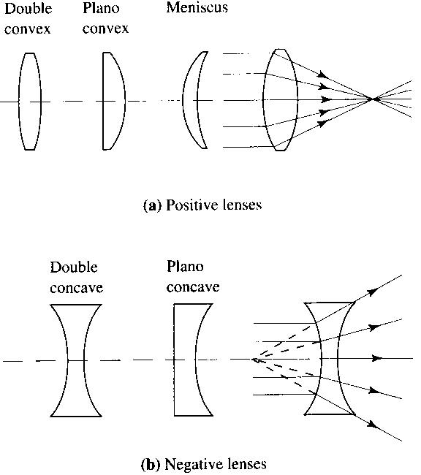
Lenses
Matrix Optics
positive
negative

Slide 8
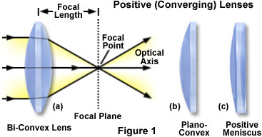
Matrix Optics
Question 1: for a Plano-Convex lens, in a focusing application such as the one illustrated on the left, which side would you choose?

Slide 9
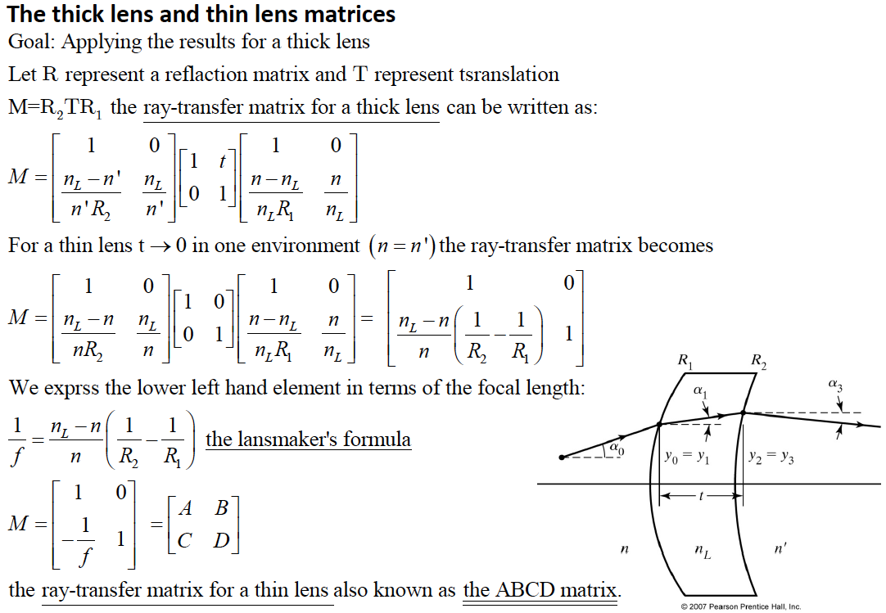

Slide 10
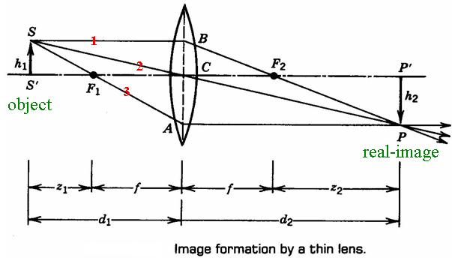
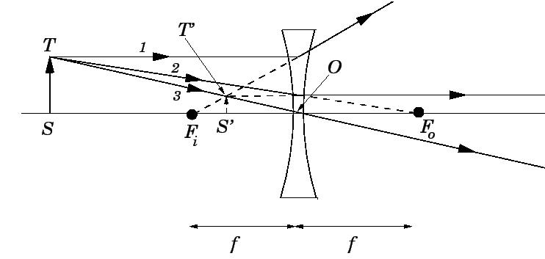
Image Formation by thin Lenses
Matrix Optics
Lens equation:

Slide 11
Matrix Optics
Homework 1: demonstrate by using the ABCD matrix the lens imaging equation
Lens equation:
Homework 2: Calculate by using ABCD matrix the magnification h2/h1 as a function of the lens focal f and the image distance from the lens d1

Slide 12
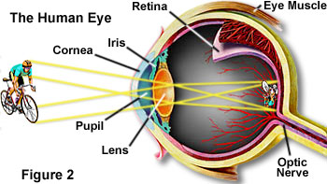
Imaging formation by the human eye
The human eye works as a single lens imaging system where the image is spherically projected on the retina

Slide 13

Aberrations of Lenses
Primary Aberration ⎯ image deviate from the original picture/the first-order approximation
Monochromatic aberrations
⎯ Spherical Aberration
⎯ Coma
⎯ Astigmatism
⎯ Curvature of field
⎯ Distortion
Chromatic aberration

Slide 14
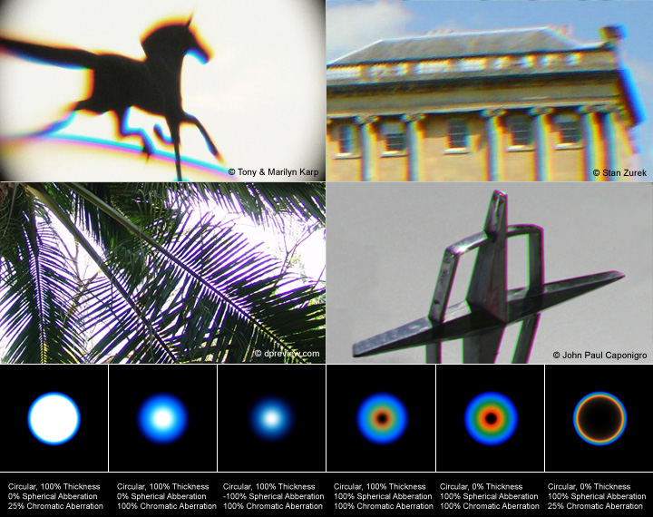
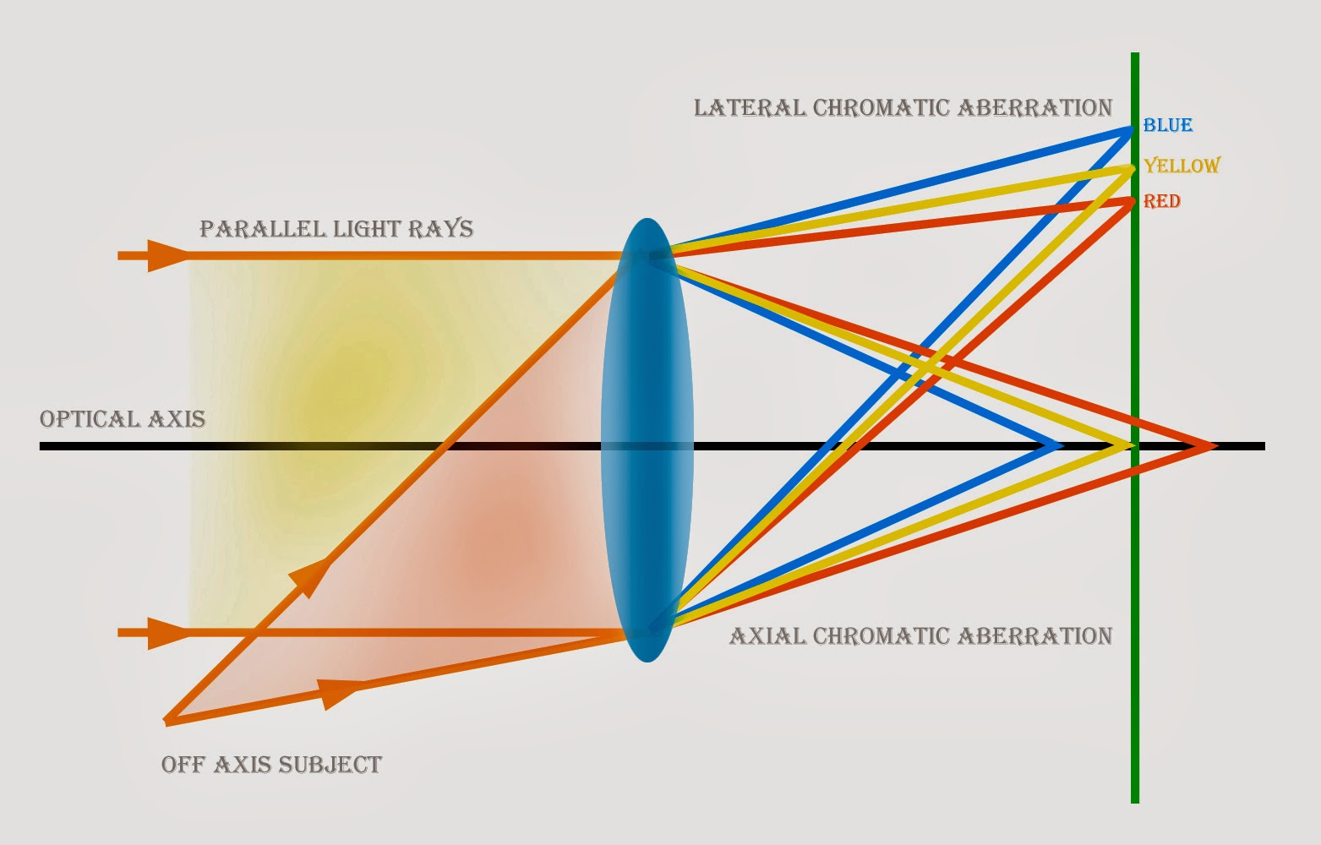
Chromatic Aberration
Due to the dispersive nature of the lens material, the focal lengths of lights with distinct wavelengths are different -> white spots are imaged as polychromatic spots

Slide 15
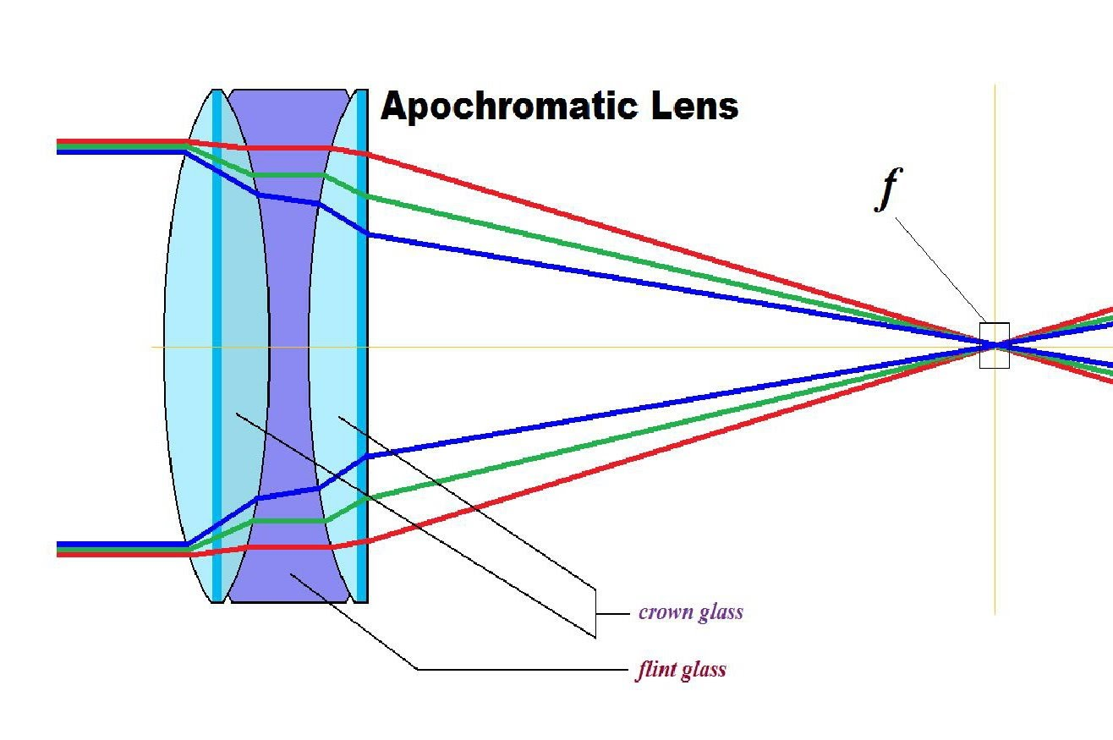
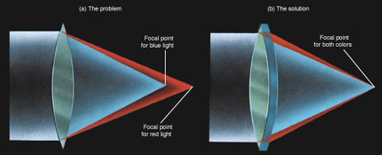
Solution of Chromatic Aberration-Using Doublet or triplet Lens
Achromatic
doublet

Slide 16
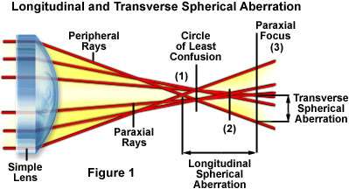
Spherical Aberration (SA)

Slide 17
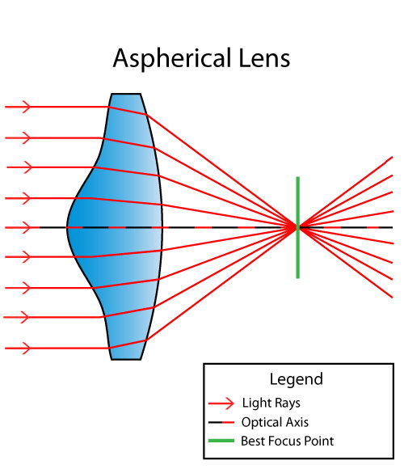
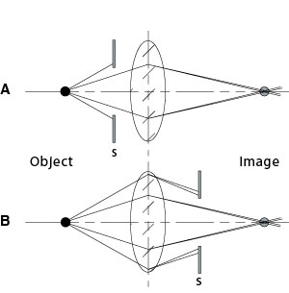
Solutions of Spherical Aberration-Using Aspherical Lens or Stop

Slide 18
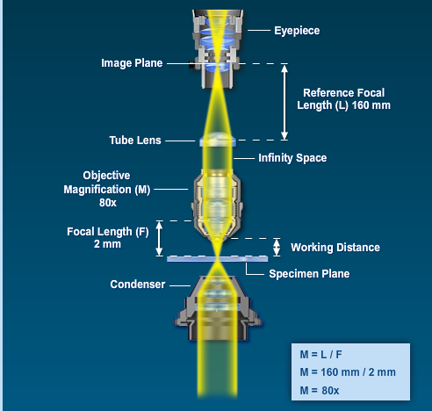
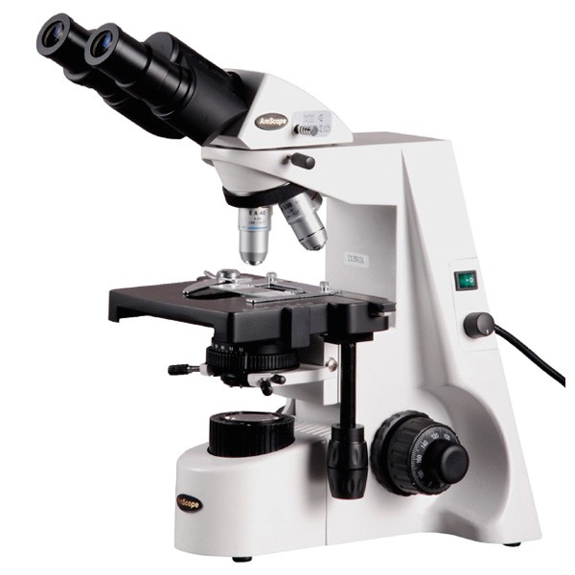
Optical Microscope
http://zeiss-campus.magnet.fsu.edu/tutorials/

Slide 19
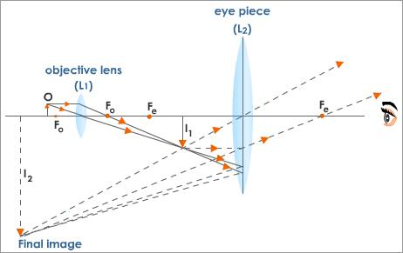
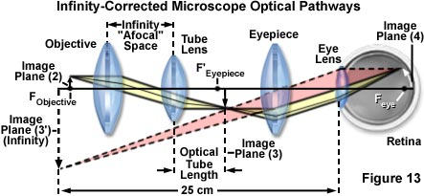
Microscope Theory
Traditional microscope:
An objective forms the image that is further magnified by the eyepiece lens.
Modern microscope:
The image is formed by an infinity corrected objective, which produces parallel rays, and a tube lens, which focus the rays into the intermediate image plane. The image is further magnified by the eyepiece lens.

Slide 20
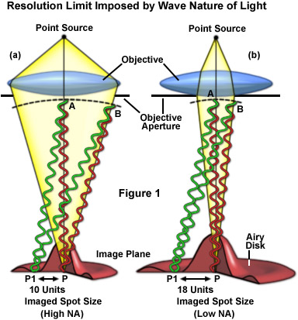
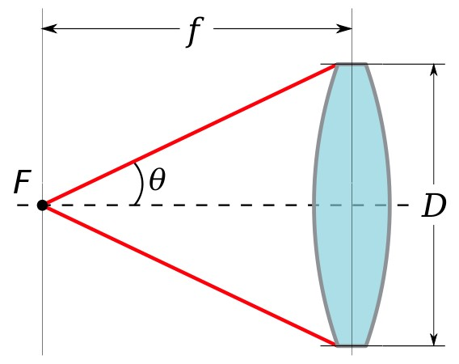
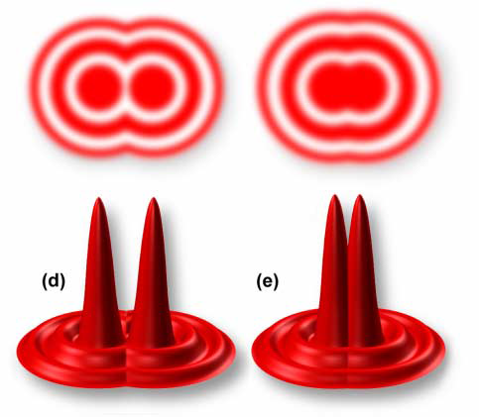
Numerical Aperture (NA)
Microscope Resolution
The numerical aperture NA of an optical system is a dimensionless number that characterizes the range of angles over which the system can accept or emit light.
Due to the wave nature of light, a point source is imaged into a complex pattern composed by a bright spot and multiple interference fringes -> airy disk. This phenomenon is due to diffraction, which will be introduced in the next lessons.
The diffraction limited (DL) resolution of the microscope is (Rayleigh limit):
According to the Rayleigh criterion, two point sources observed in the microscope are regarded as being resolved when the principal diffraction maximum (the central spot of the Airy disk) from one of the point sources overlaps with the first minimum (dark region surrounding the central spot) of the Airy disk from the other point source.

Slide 21
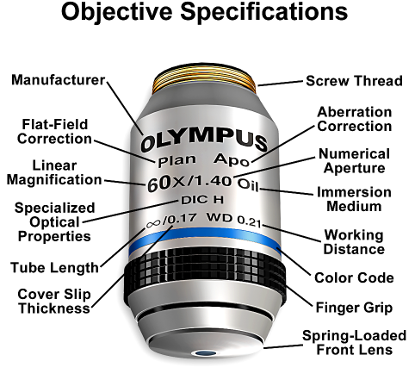
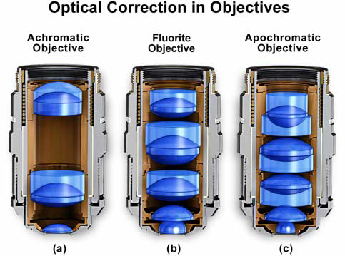
Microscope Objectives
Microscope objectives can be quite complex optical systems, composed by many lens. All the information regarding the objective are engraved in the objective barrel.
Aberrations are corrected at different levels, from achromatic objectives (the simplest and most economic) to apochromatic (most expensive)

Slide 22
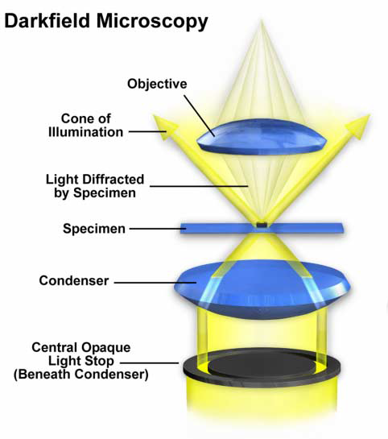
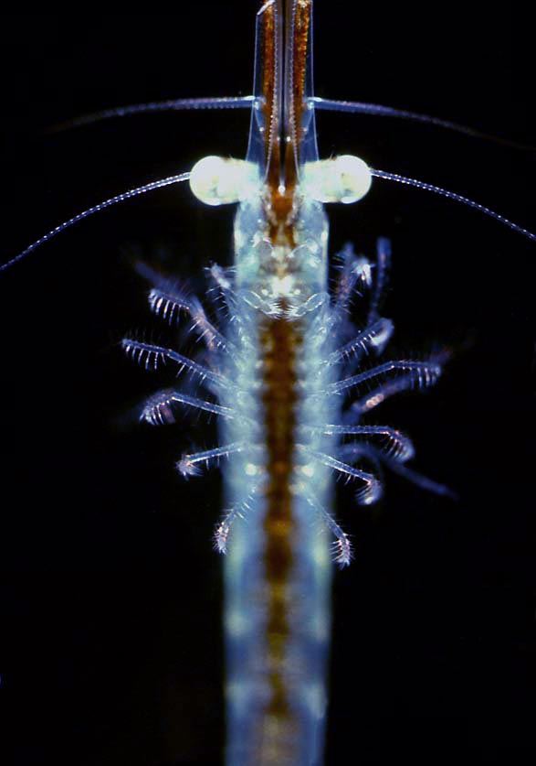
Microscopy Techniques
mysis zooplankton

Slide 23
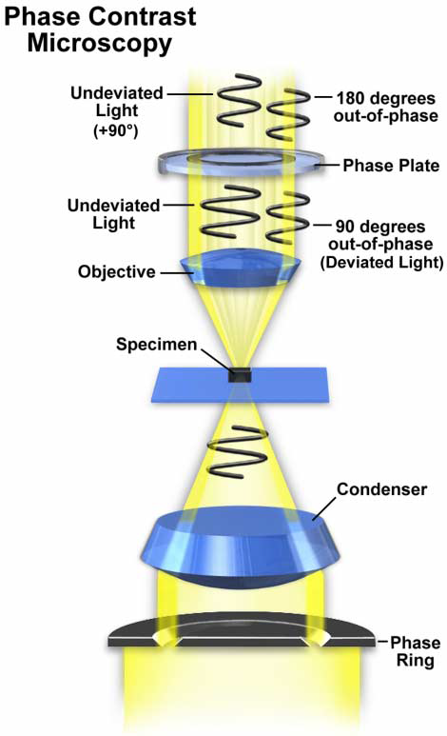
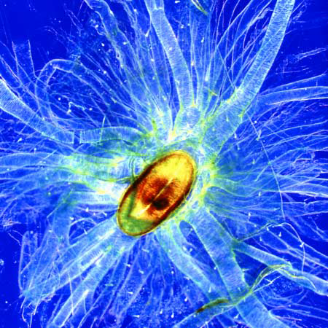
Microscopy Techniques
Silkworm

Slide 24
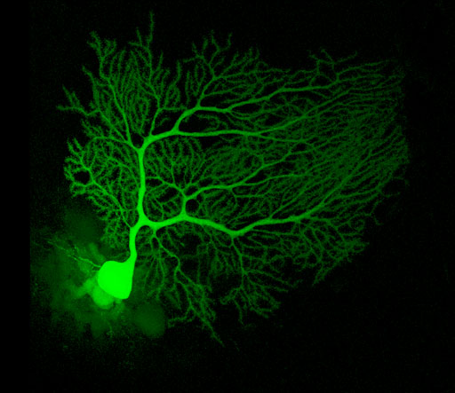
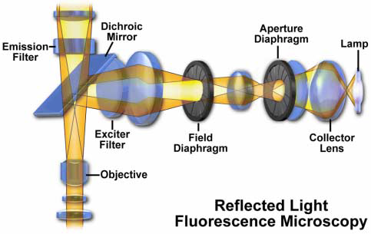
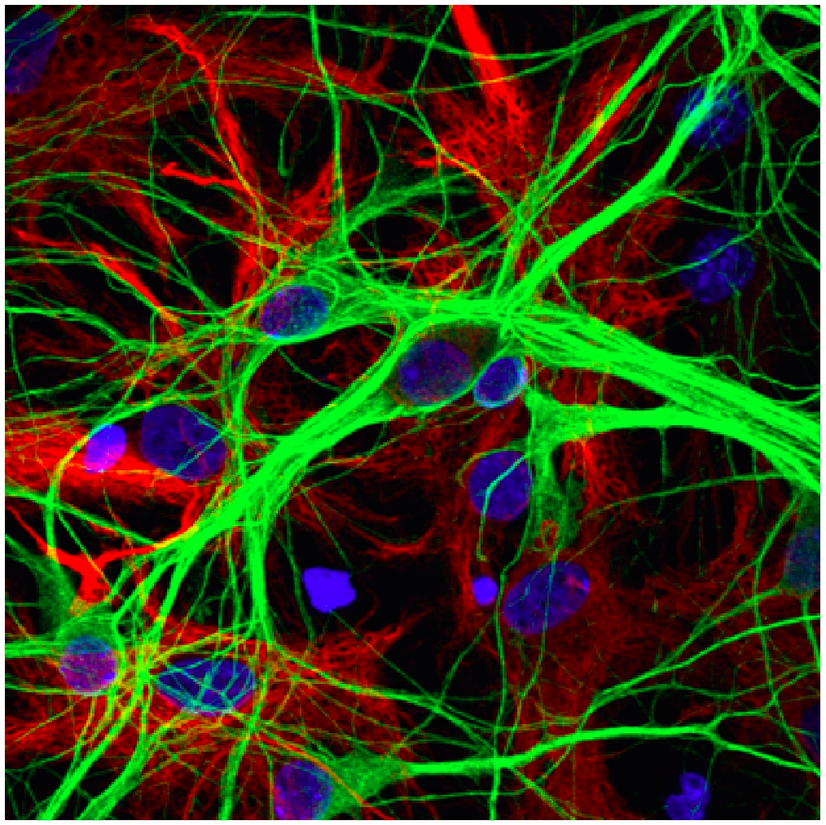
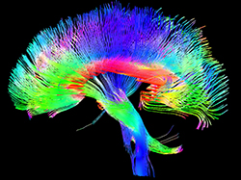
Microscopy Techniques
Cerebellum
Nervous system
Brain neurons

Slide 25
Matrix Optics and Imaging theory
References
A. Yariv, P. Yeh, Photonics, 6th Ed., Chapter 2
M. Born and E. Wolf, Principle of Optics, 6th Ed., Chapter 3.
F. Pedrotti, L. M. Pedrotti and L. S. Pedrotti, “Introduction to Optics” (Prentice Hall, 2007)
https://www.olympus-lifescience.com/en/microscope-resource/
Davidson, Michael W. and Abramowitz, Mortimer, Optical Microscopy, Encyclopedia of Imaging Science and Technology, Wiley, 2002, doi = {10.1002/0471443395.img074}

