Slide 1
EE 231 Introduction to Optics
Scalar theory of diffraction
Lesson 3
Andrea Fratalocchi
www.primalight.org

Slide 2
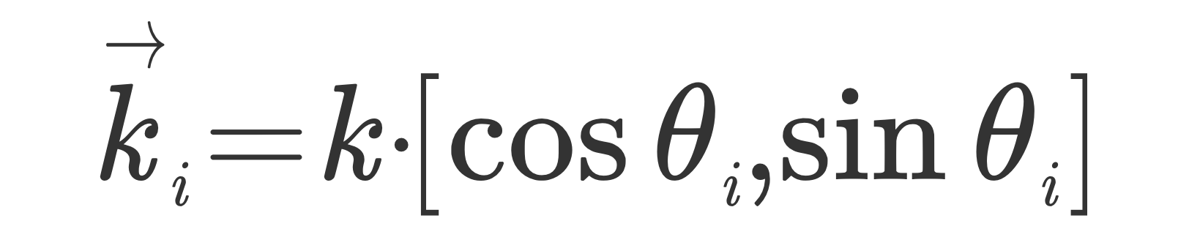
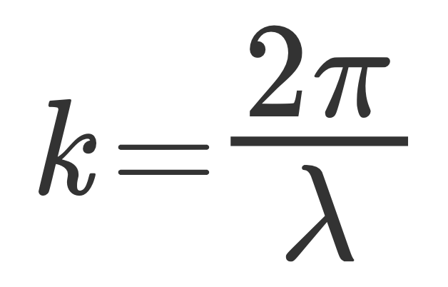
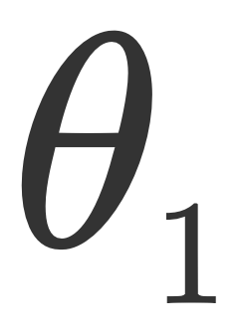
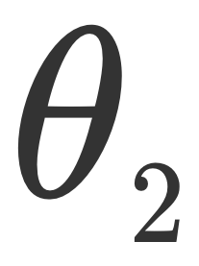
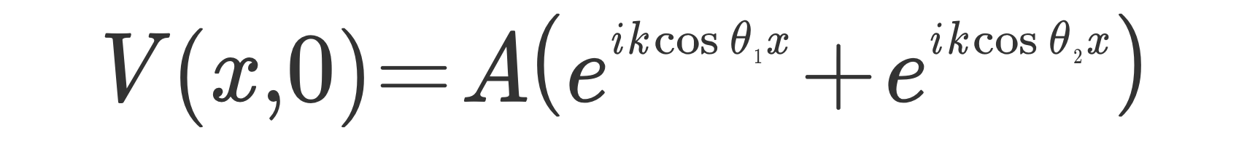



The Scalar theory of diffraction
The input scalar field at z=0 is:
To calculate the expression of the field at a generic z, we propagate each plane wave and sum them up:
Propagation of each plane wave
Sum up the contributions

Slide 3
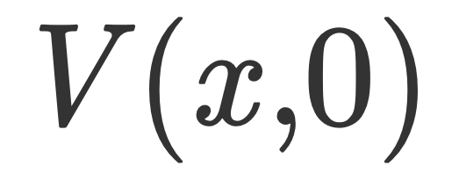
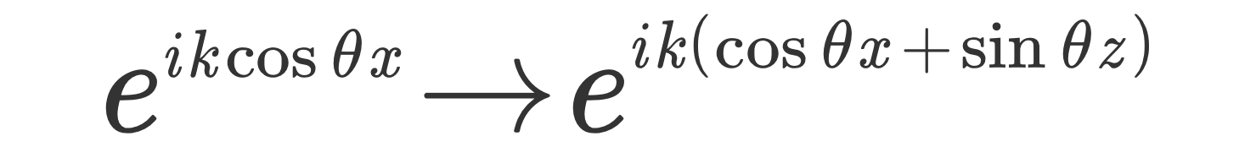
The Scalar theory of diffraction
We are using a standard technique to study the propagation of waves, called normal modes decomposition
Propagation
Expand the field into waves whose propagation is known
3. Sum up all the contributions
2. Propagate each component

Slide 4
The Scalar theory of diffraction
We are using a standard technique to study the propagation of waves, called normal modes decomposition
Propagation
3. Sum up all the contributions
Expand the field into waves whose propagation is known
2. Propagate each component
Question: is this approach something new?

Slide 5
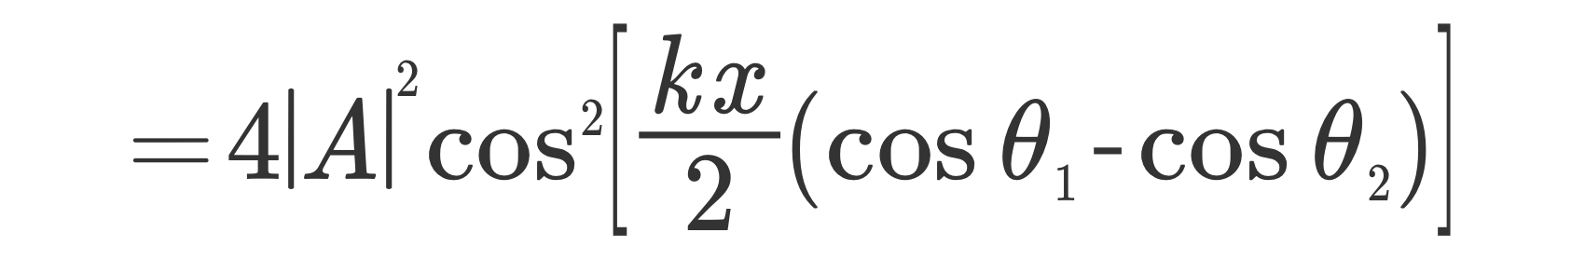

The Scalar theory of diffraction
The Intensity distribution:
Interference term

Slide 6
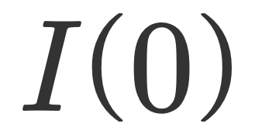
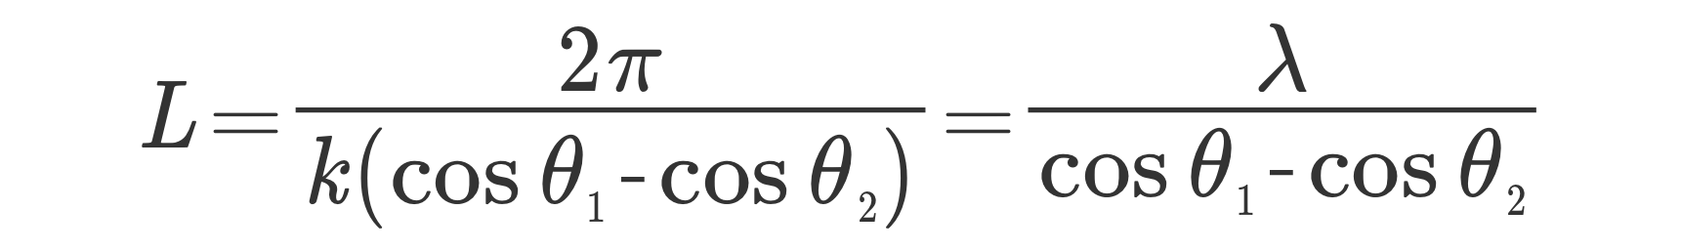
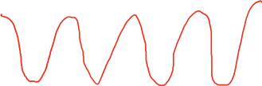

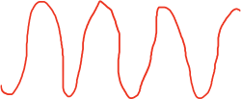
The Scalar theory of diffraction
The Intensity distribution:
Interference fringes

Slide 7
The Scalar theory of diffraction
Question: how can I use this effect in real world applications?

Slide 8
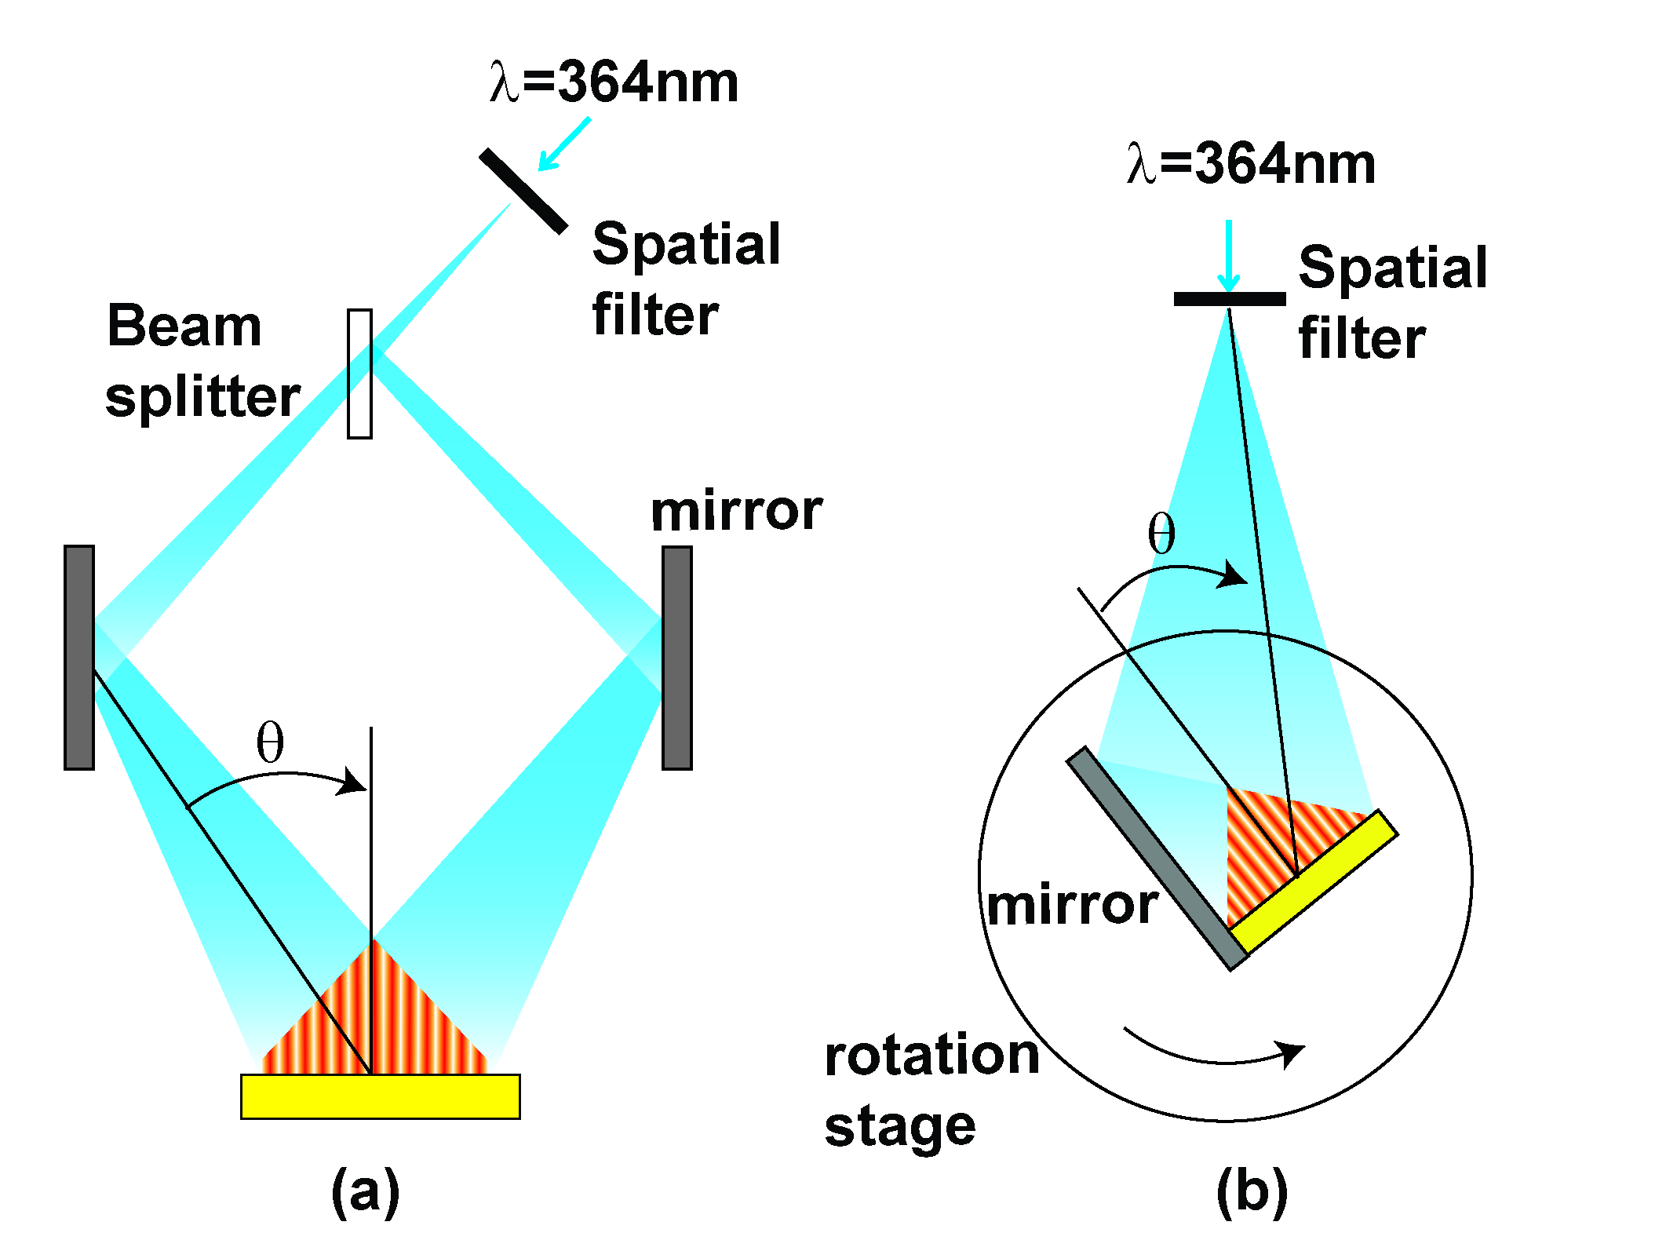
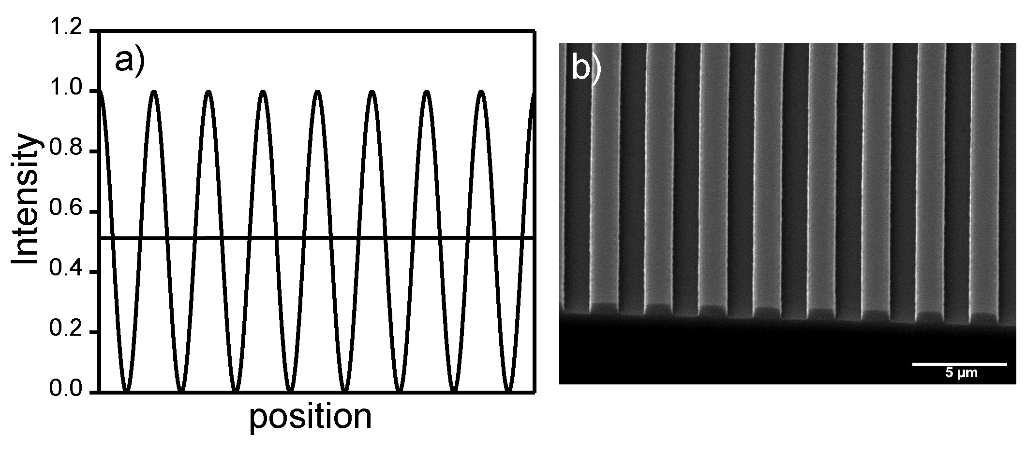
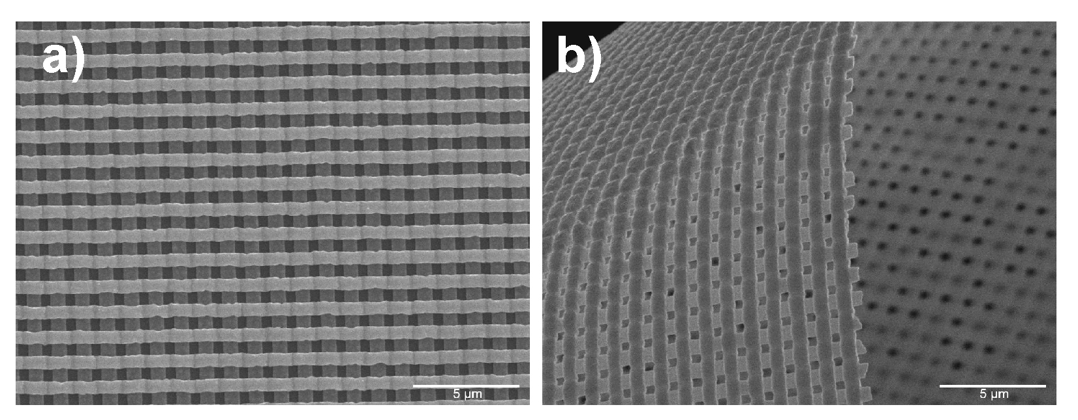
The Scalar theory of diffraction
Question: how can I use this effect in real world applications?
1) Laser interference lithography

Slide 9
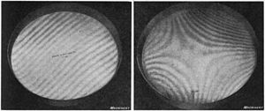
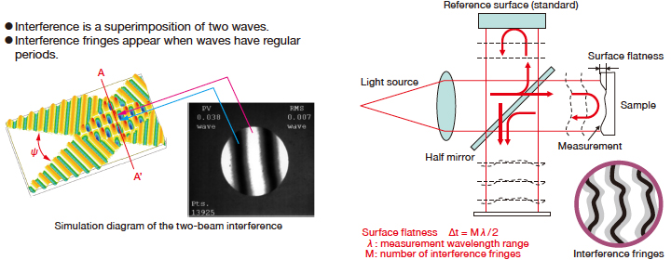
The Scalar theory of diffraction
Question: how can I use this effect in real world applications?
2) Interferometric detection: can you explain how the scheme below works?

Slide 10
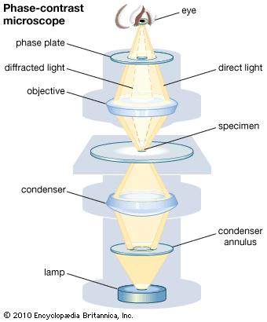
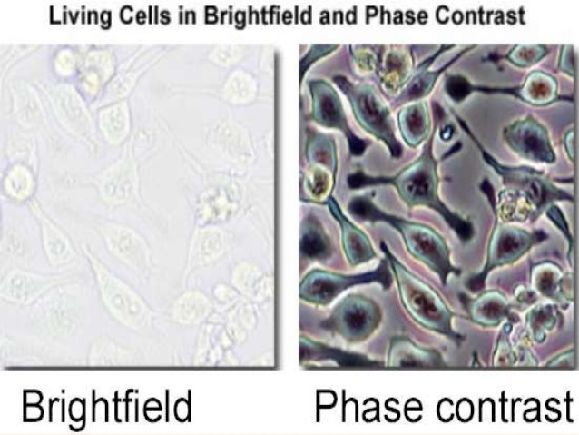
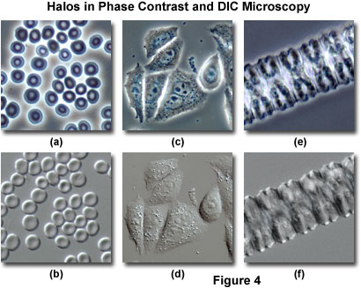
The Scalar theory of diffraction
Question: how can I use this effect in real world applications?
3) Bio-imaging: phase contrast microscopy

Slide 11
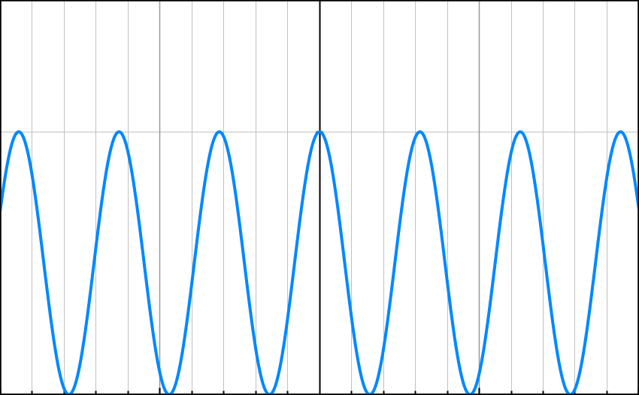




The Scalar theory of diffraction
Question: what is the distribution of the Intensity at z>0?

Slide 12
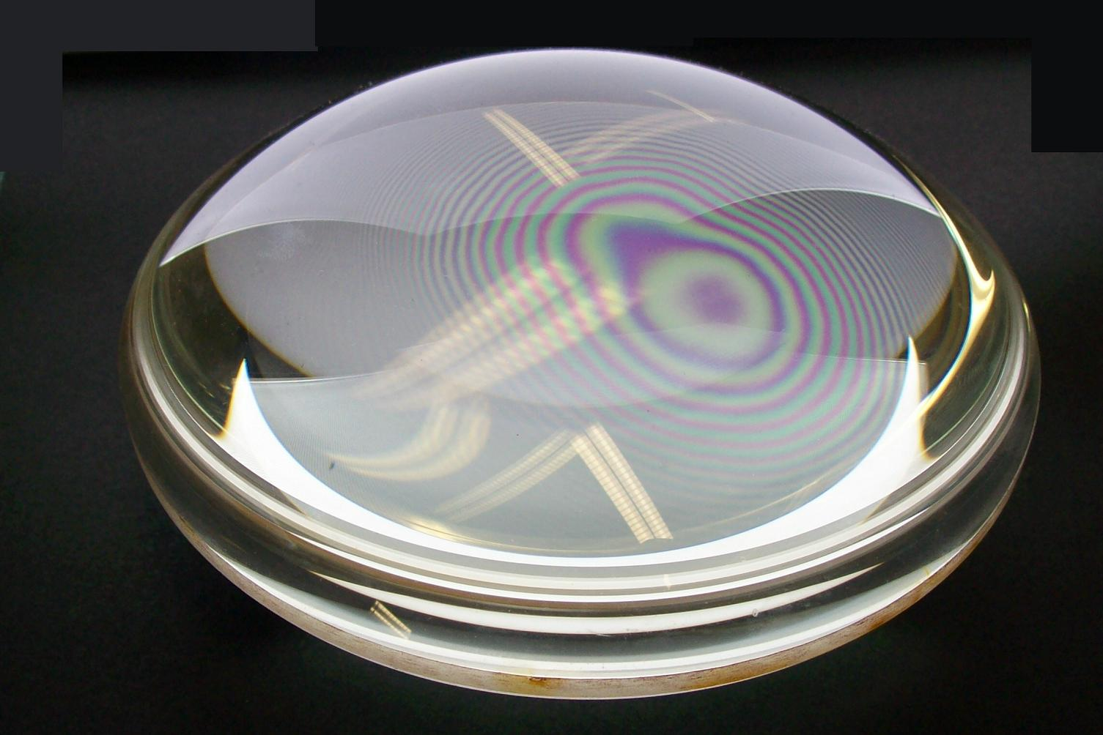
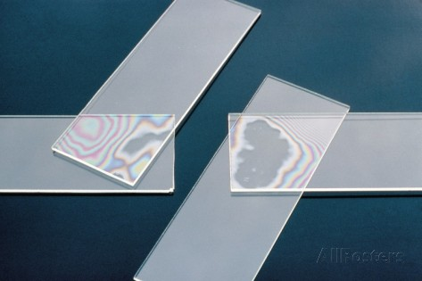
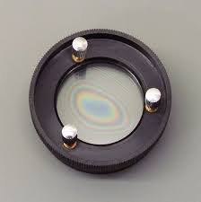
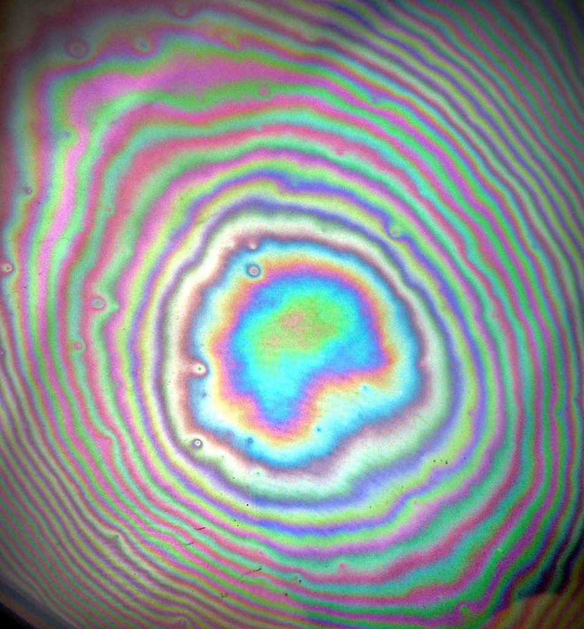
The Scalar theory of diffraction
Other common and interesting circular interference fringes in optics:
Question 1: how these are generated?
Question 2: how to model these phenomena and understand their properties?

Slide 13
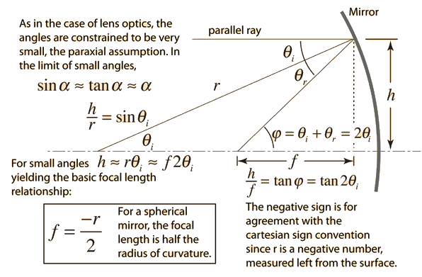





The Scalar theory of diffraction
Question 1: how these are generated?
Question 2: how to model these phenomena and understand their properties?
interference between two spherical waves!

Slide 14
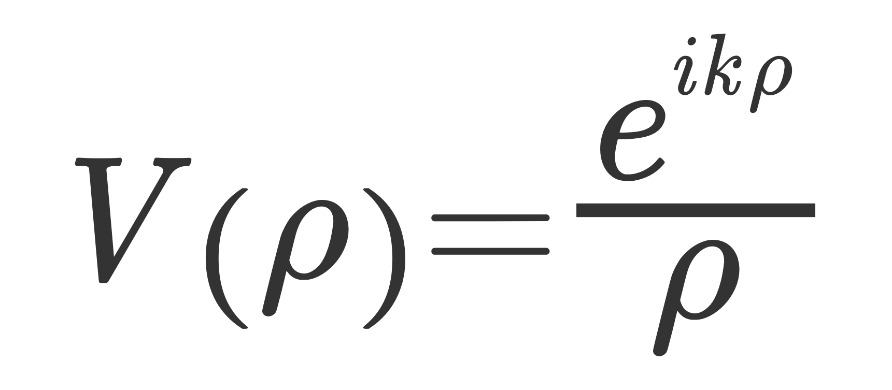
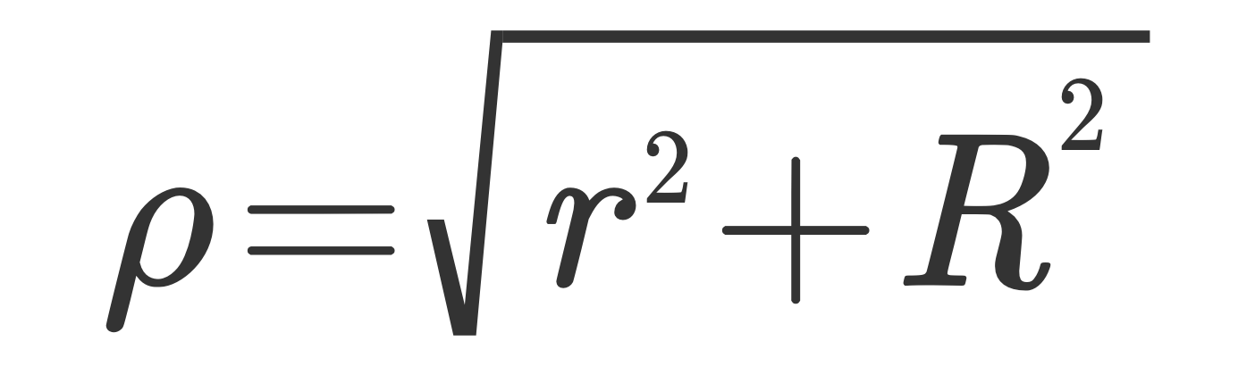

The Scalar theory of diffraction
Question 1: how these are generated?
Question 2: how to model these phenomena and understand their properties?
Spherical wave:
Exercise: verify the expression above

Slide 15
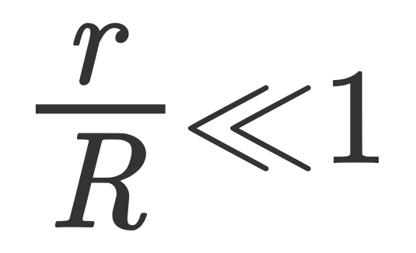
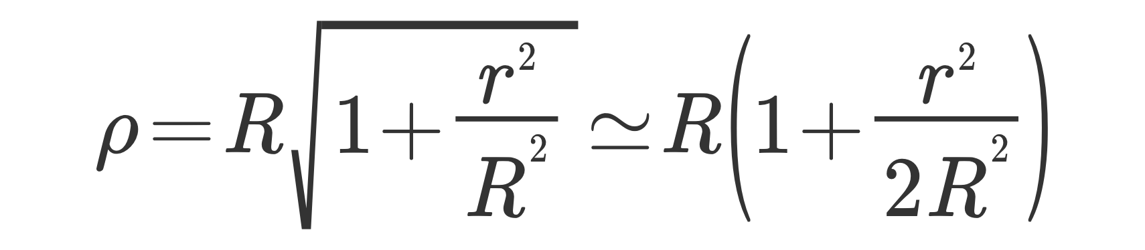
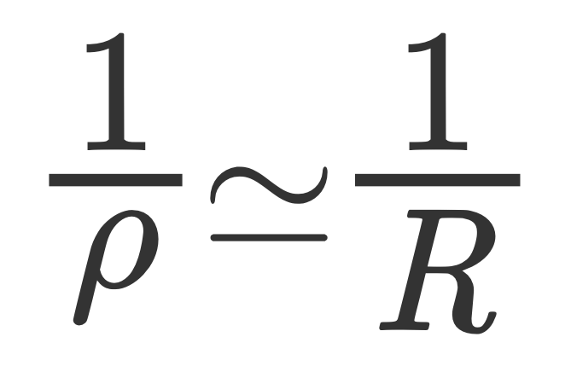
The Scalar theory of diffraction
Question 1: how these are generated?
Question 2: how to model these phenomena and understand their properties?
Spherical wave:
If we consider a small displacement along r:
Paraxial approximation

Slide 16
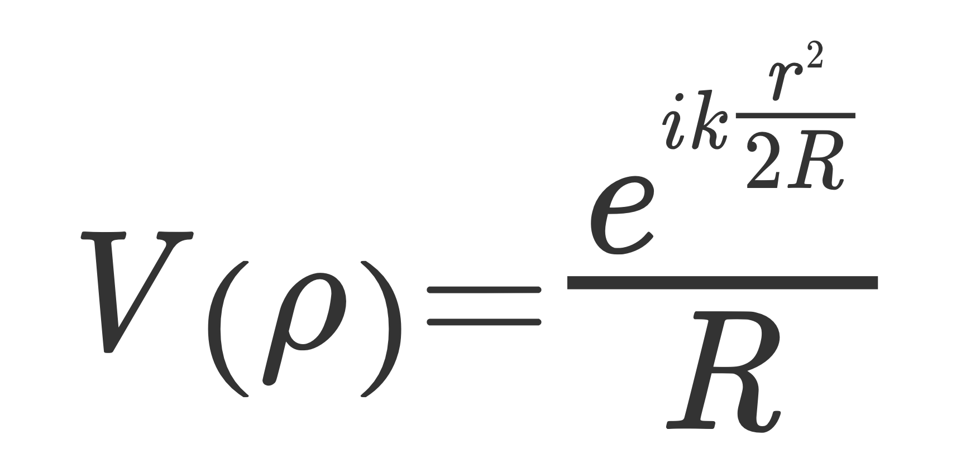
The Scalar theory of diffraction
Question 1: how these are generated?
Question 2: how to model these phenomena and understand their properties?
If we consider a small displacement along r:
Paraxial approximation
Expression of spherical wave in par axial approximation. We discarded all proportionality constants

Slide 17
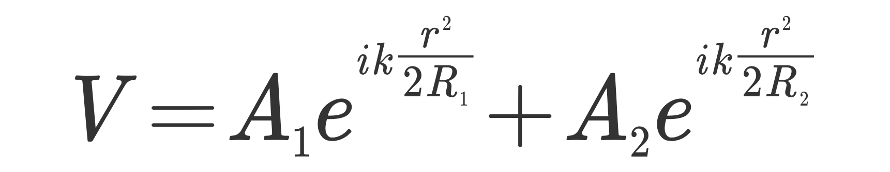
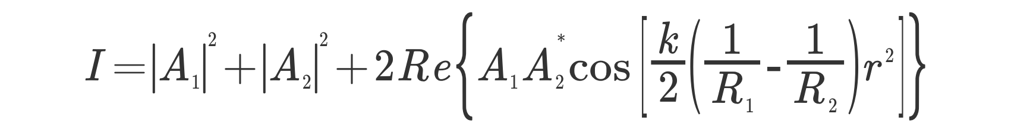




The Scalar theory of diffraction
Question 1: how these are generated?
Question 2: how to model these phenomena and understand their properties?
Real A1 and A2
x
y

Slide 18


The Scalar theory of diffraction
Homework 1: what happens to the reflections components drawn in orange? Do they contribute to the interference?

Slide 19
The Scalar theory of diffraction
Homework 2: why we see different colors in the interference pattern?

Slide 20
The Scalar theory of diffraction
References
M. Born and E. Wolf, Principle of Optics, 6th Ed., Chapter 1, Chapter 7

