Slide 1
EE 231 Introduction to Optics
Scalar theory of diffraction
Lesson 4
Andrea Fratalocchi
www.primalight.org

Slide 2
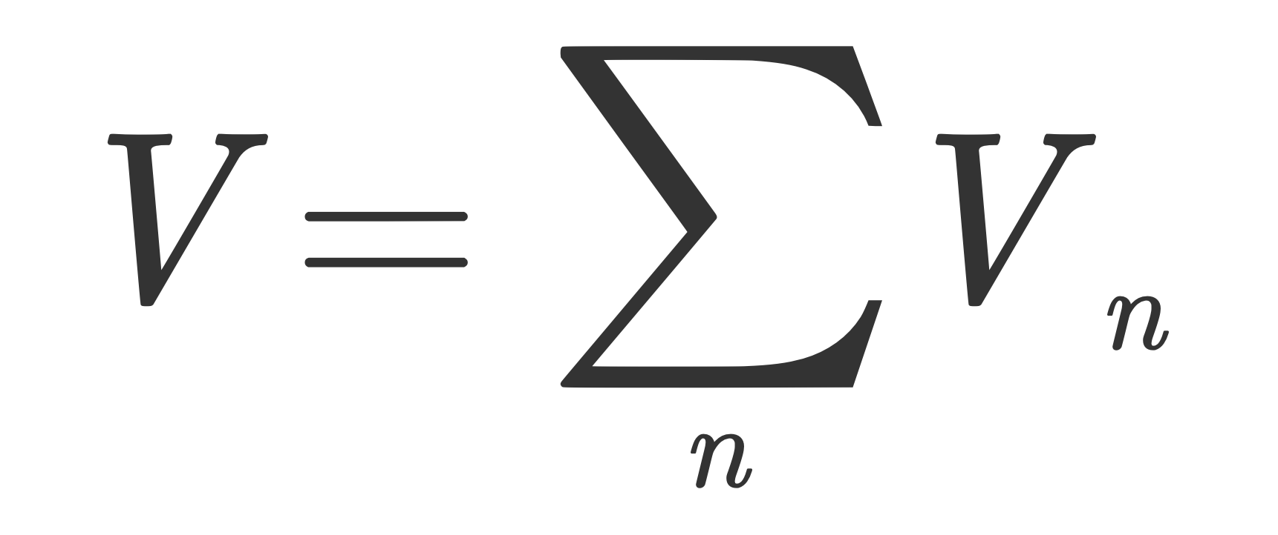
The Scalar theory of diffraction
coherent term (Interference)
Interference and coherence
Incoherent term
Interference is only observed in coherent fields, which have a constant phase difference at the same frequency. The incoherent term, conversely, is always observed.

Slide 3
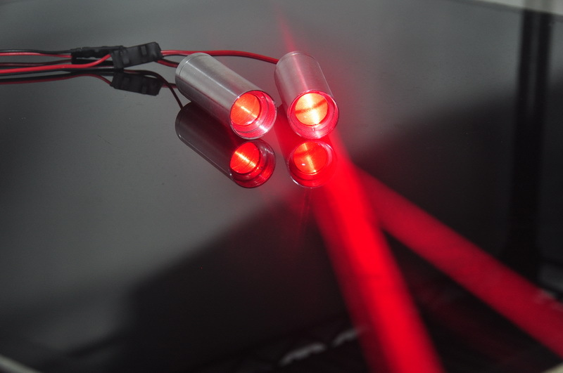
The Scalar theory of diffraction
Interference and coherence
Interference is only observed in coherent fields, which have a constant phase difference at the same frequency. The incoherent term, conversely, is always observed.
fluctuating in time
No interference term!

Slide 4
The Scalar theory of diffraction: elements of coherence theory
Quasi-monochromatic source
Stochastic process
Mutual coherence of V1 and V2 at different times
Statistical average
Assuming the stochastic process associated to V1 and V2 ergodic and stationary:
time average
Degree of spatio-temporal coherence:
Experimentally Observable

Slide 5
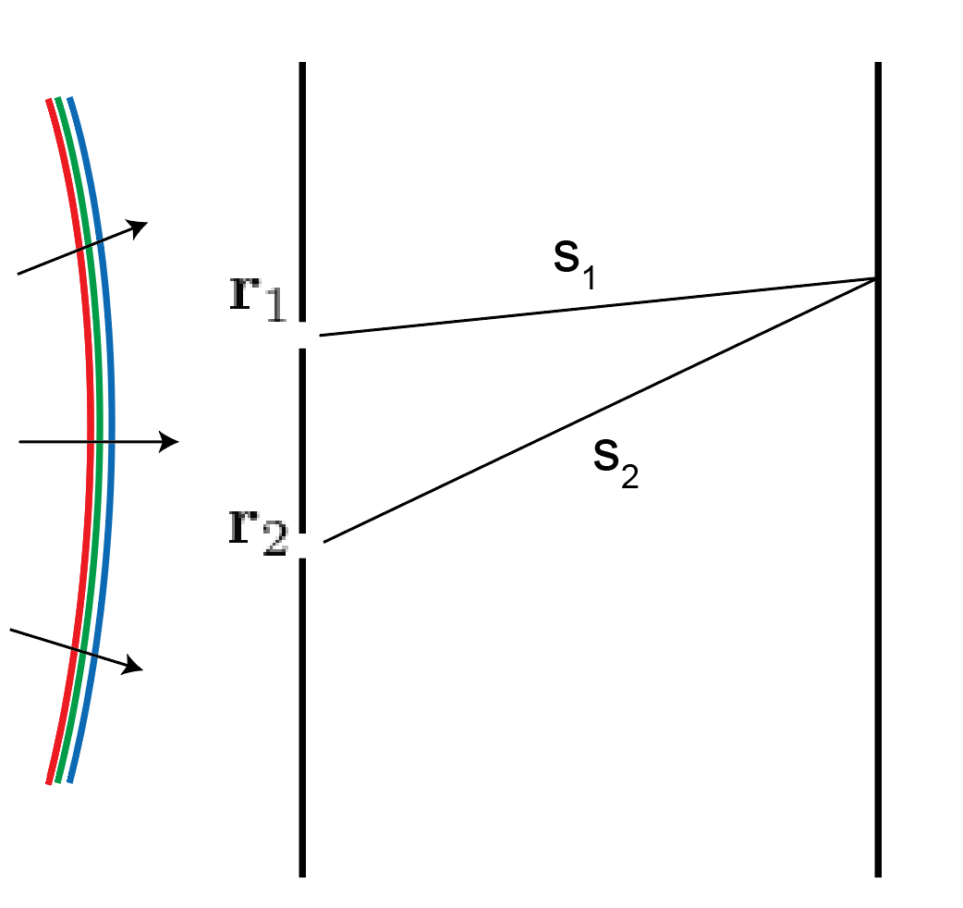
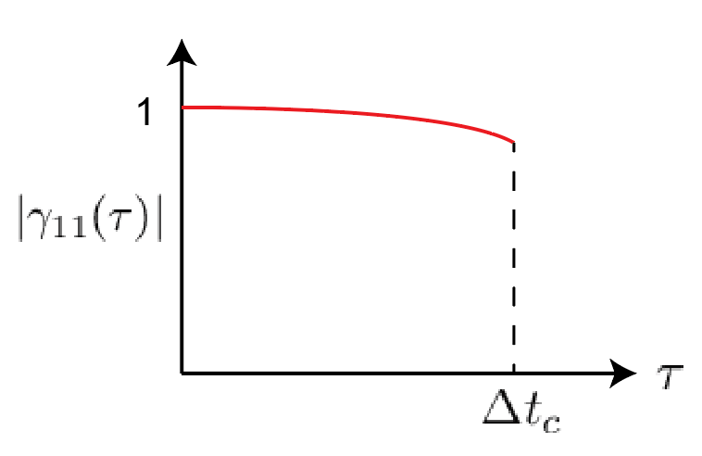
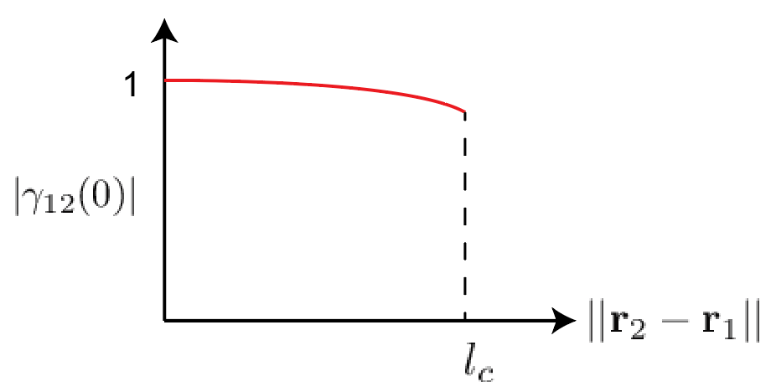
The Scalar theory of diffraction: elements of coherence theory
Degree of coherence:
Q
Intensity measured at Q
Interference term
Temporal coherence
Spatial coherence
Coherence time:
Coherence length:

Slide 6
The Scalar theory of diffraction: elements of coherence theory
Coherence length:
Lasers
Inexpensive semiconductors: cm
Semiconductors: can reach 100 m
cw lasers: can reach a few km
Light sources
Black-body radiation (sun, tungsten filaments):
few to tens of microns
LEDs: a few microns

Slide 7
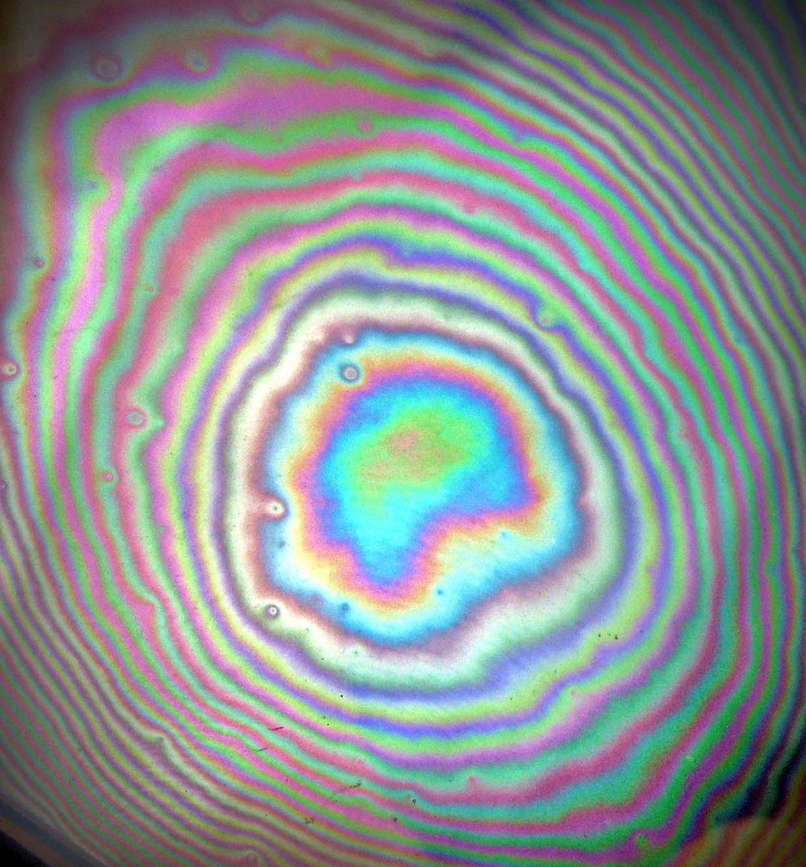
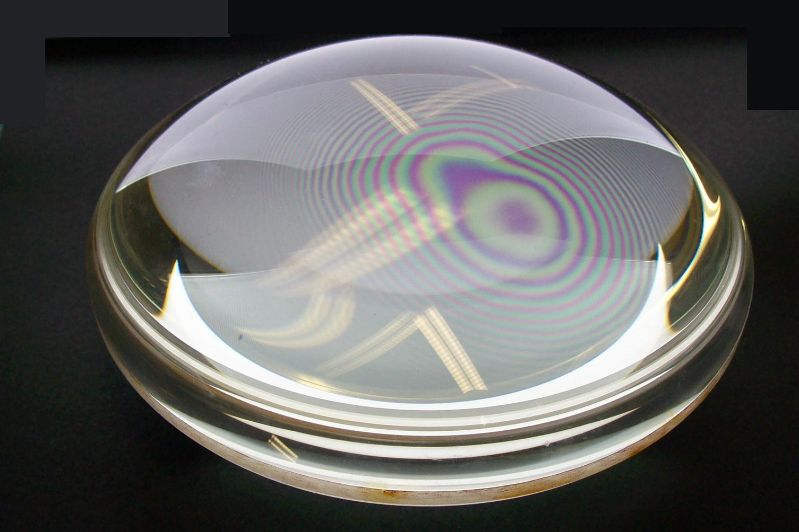
The Scalar theory of diffraction
Homework 2: why we see different colors in the interference pattern?

Slide 8
The Scalar theory of diffraction
Homework 2: why we see different colors in the interference pattern?
The period of the interference fringe is directly proportional to the wavelength: longer wavelengths have larger period
Interference introduced a dispersive effect: a response in intensity that affects light differently according to the input frequency

Slide 9
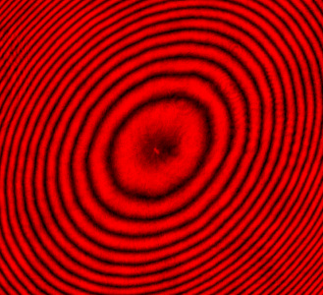
The Scalar theory of diffraction
Can we apply this phenomenon, known as Newton rings (discovered in 1717), for developing applications?

Slide 10
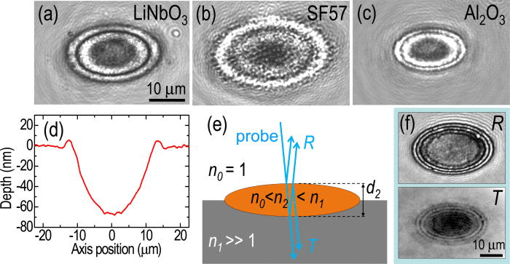
The Scalar theory of diffraction
Can we apply this phenomenon, known as Newton rings (discovered in 1717), for developing applications?
Ultrafast spectroscopy of femtosecond ablated materials
Appl. Phys. Lett. 105, 112902 (2014); http://dx.doi.org/10.1063/1.4895926

Slide 11
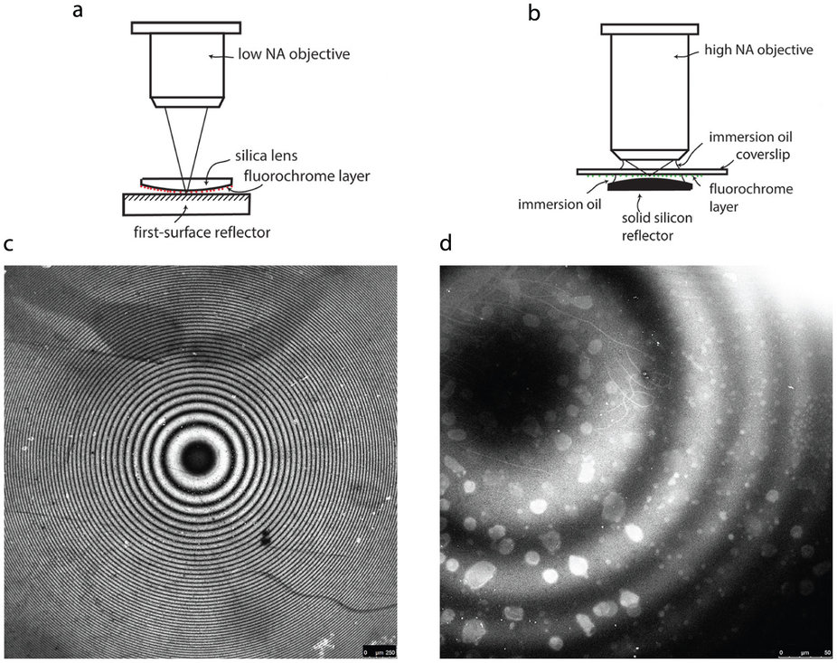
The Scalar theory of diffraction
Can we apply this phenomenon, known as Newton rings (discovered in 1717), for developing applications?
Multi planar fluorescence microscopy
Standing-wave excitation of fluorescence is highly desirable in optical microscopy because it improves the axial resolution. We demonstrate here that multiplanar excitation of fluorescence by a standing wave can be produced in a single-spot laser scanning microscope by placing a plane reflector close to the specimen. We report here a variation in the intensity of fluorescence of successive planes related to the Stokes shift of the dye. We show by the use of dyes specific for the cell membrane how standing-wave excitation can be exploited to generate precise contour maps of the surface membrane of red blood cells, with an axial resolution of ≈90 nm. The method, which requires only the addition of a plane mirror to an existing confocal laser scanning microscope, may well prove useful in studying diseases which involve the red cell membrane, such as malaria.
Scientific Reports 4, 7359 (2014);
doi:10.1038/srep07359

Slide 12
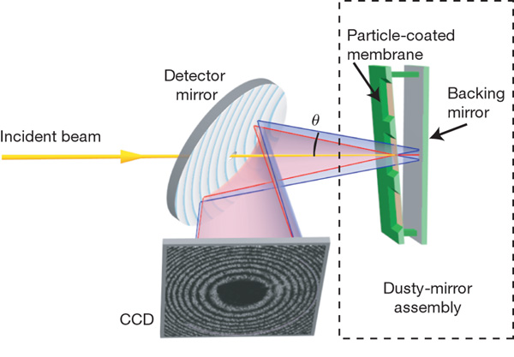
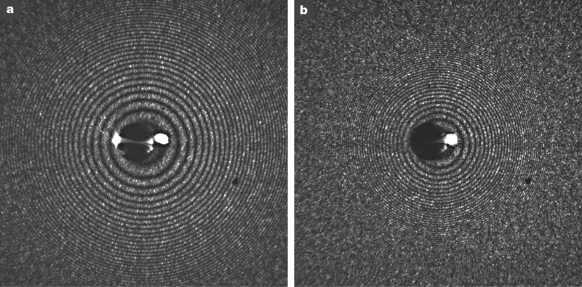
The Scalar theory of diffraction
Can we apply this phenomenon, known as Newton rings (discovered in 1717), for developing applications?
Femtosecond time-delay X-ray holography
Nature 448, 676-679 (9 August 2007) | doi:10.1038/nature06049
Here we propose and apply a simple holographic measurement scheme, inspired by Newton's 'dusty mirror' experiment, to monitor the X-ray-induced explosion of microscopic objects. The sample is placed near an X-ray mirror; after the pulse traverses the sample, triggering the reaction, it is reflected back onto the sample by the mirror to probe this reaction. The delay is encoded in the resulting diffraction pattern to an accuracy of one femtosecond, and the structural change is holographically recorded with high resolution. We apply the technique to monitor the dynamics of polystyrene spheres in intense free-electron-laser pulses, and observe an explosion occurring well after the initial pulse. Our results support the notion that X-ray flash imaging2, 3 can be used to achieve high resolution, beyond radiation damage limits for biological samples4. With upcoming ultrafast X-ray sources we will be able to explore the three-dimensional dynamics of materials at the timescale of atomic motion.

Slide 13
The Scalar theory of diffraction
Exercise: calculate the intensity distribution arising from the interference between a plane wave and a spherical wave

Slide 14
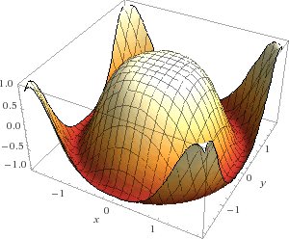
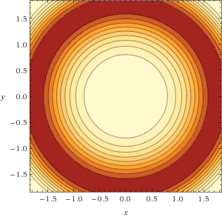
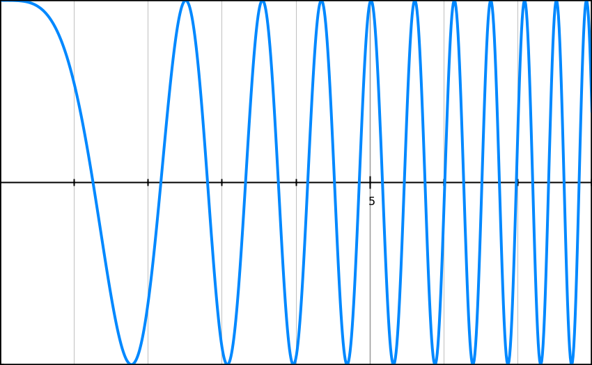
The Scalar theory of diffraction
Exercise: calculate the intensity distribution arising from the interference between a plane wave and a spherical wave

Slide 15
The Scalar theory of diffraction
Homework 1: How many interference fringes N are found in a disc of radius a?
Do the calculation in paraxial and non paraxial approximation. Compare N in the case of R=1m, wavelength 500nm, disc radius a=20mm for paraxial and non paraxial calculations. What is the difference between the two cases?

Slide 16
The Scalar theory of diffraction
References
M. Born and E. Wolf, Principle of Optics, 6th Ed., Chapter 1, Chapter 7.
L. Mandel, E. Wolf, Optical Coherence and Quantum Optics, 1995, Chapter 4.

